Slide 1
Discover the
European Citizens’ Initiative
Webinar – 3 May 2022

Slide 2
What you can expect
Welcome and short quiz
Discover the ECI – why does the ECI matter?
Q&A with ECI organisers – why choose an ECI?
Diving deeper with the ECI Forum – what support is there for organisers?
Close @ 19:30

Slide 3
How to take part today
Vote in the Slido quiz
Write in the chat
Q&A time – raise your hand digitally
+ wait to be called on
  Moderator will state your name + tech host gives ability to enable video and microphone
Fill out the feedback survey

Slide 4
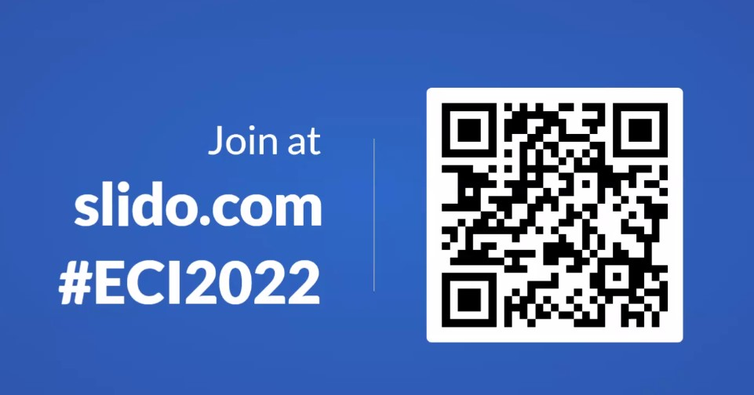
Let’s see who is here & test your knowledge

Slide 5
Discover the ECI - why does the ECI matter? Facts, figures and more
Silvia Kersemakers, ECI team leader
Secretariat-General, European Commission

Slide 6
Participatory democracy: your options at EU level
Vote or run as a candidate in European elections
European Citizens’ Initiative
EU Have Your Say Portal
Submit a petition to the European Parliament

Slide 7
What can you achieve by starting an ECI?
The European Citizens’ Initiative helps bring causes you care about to the EU level
  Spark a debate
  Raise awareness
  Trigger policy change in the EU
Notes:
*You call on the European Commission to propose new EU legislation in an area where the EU has the power to act. (EU competences and Commission powers)

Slide 8












Competences of the EU

Slide 9
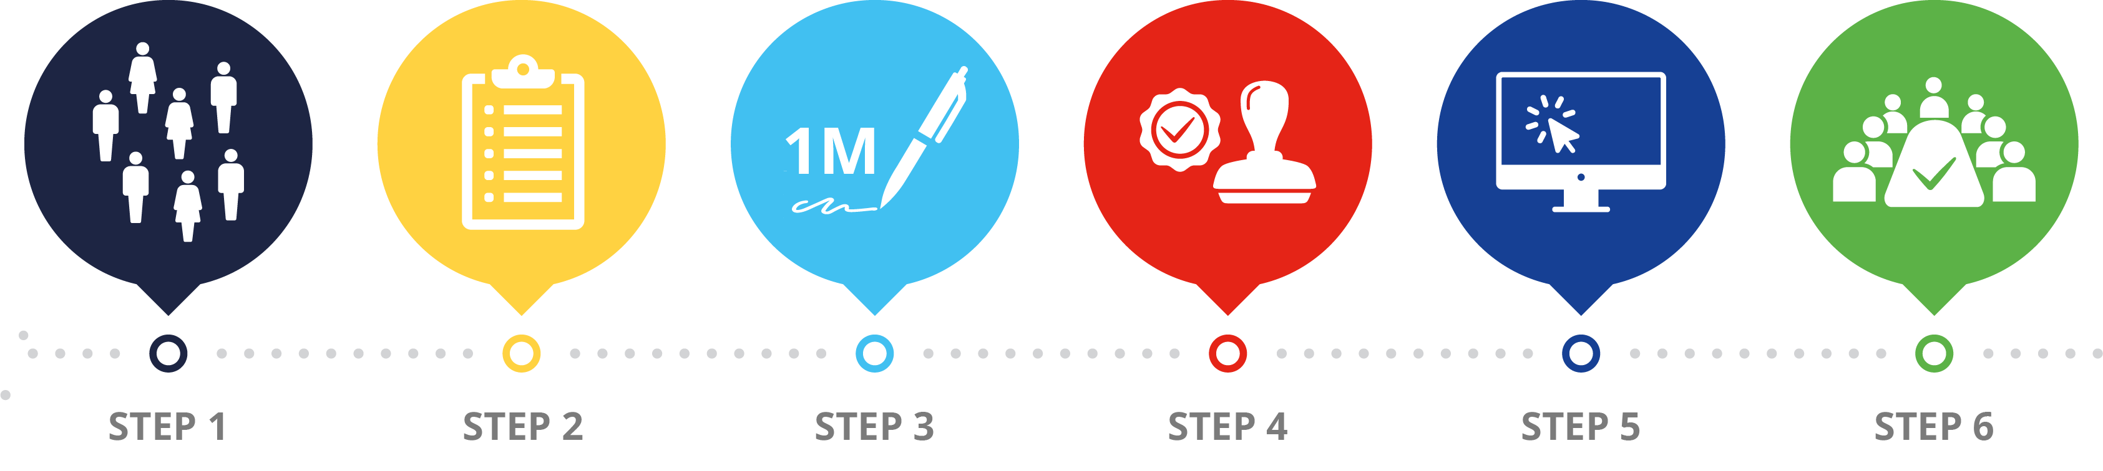
The ECI in action –
Steps to turn your idea into an ECI

Slide 10


Start and Register
Step 1: Get started with a team of 7 EU citizens
  Living in 7 different EU Member States
  Share common idea/goal
  ECI Forum provides assistance
Step 2: Commission registers (legally admissible) initiatives
  Information published with a press release and on the ECI site in all EU languages

Slide 11

Get support
Step 3: Organisers collect signatures
  Organisers have 12 months to collect 1 million statements of support (online or paper)
    European Commission provides Central Online Collection System free of charge
  Minimum numbers in a least 7 Member States
  Flexible start date with 6 months of registration
  All EU citizens old enough to vote in European Parliament elections (or aged at least 16 in some countries) can take part
Notes:
The thresholds correspond to the number of the Members of the European Parliament elected in each Member State, multiplied by the total number of Members of the European Parliament. – from 4,230 in Cyprus and Malta to 67,680 in Germany

Slide 12


Verify and Submit
Step 4: National authorities verify the validity of statements of support
Step 5: Organisers submit initiative for examination to the Commission

Slide 13

Initiative addressed by policy makers
Step 6: Organisers present their initiative
  Meeting at the European Commission
  Public hearing in the European Parliament
  The European Commission will make an official response = Communication on actions to take (in any) + reasons
  If a law is proposed, EU law-making procedures apply
  Examples: ‘Right2Water’; ‘Ban glyphosate’; ‘End the Cage Age’
Notes:
Water and sanitation are a human right! Water is a public good, not a commodity!;
Ban glyphosate and protect people and the environment from toxic pesticides;
End the Cage Age
Others: Stop Finning …

Slide 14
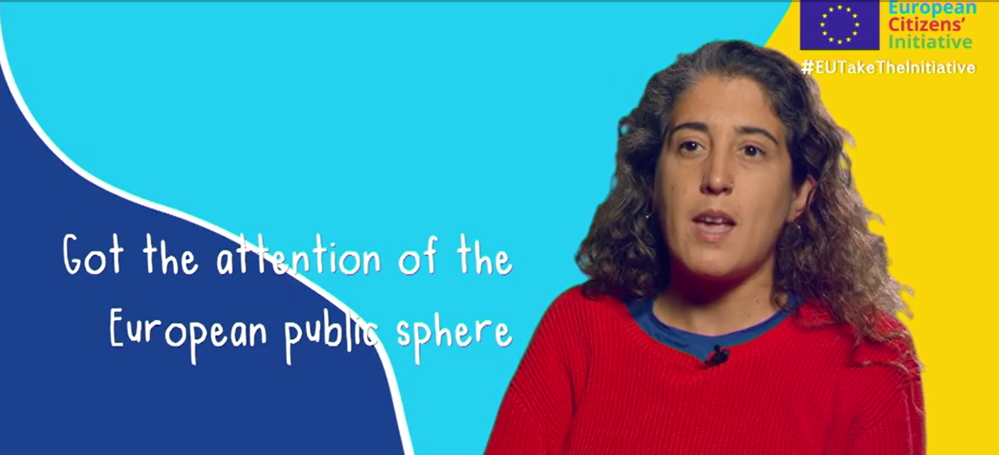
Facts & Figures – overview since 2012
89 initiatives registered
16 initiatives
collecting signatures
4 initiatives under verification
6 initiatives replied to by the EC
Notes:
Video: https://audiovisual.ec.europa.eu/en/video/I-214692?&lg=INT

Slide 15
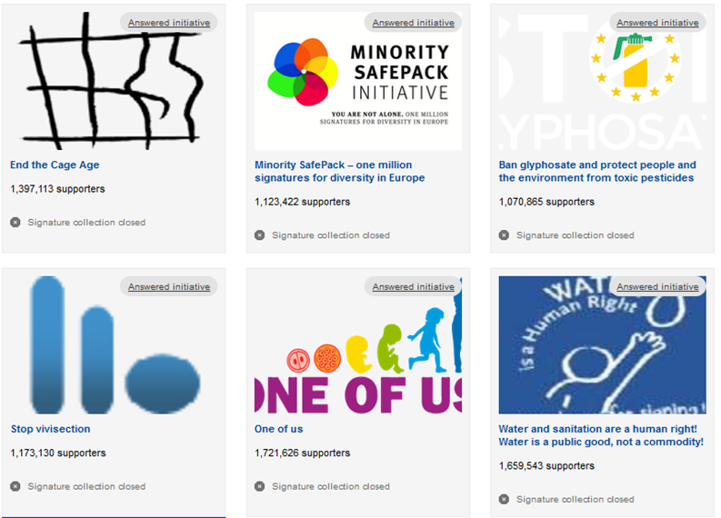
Successful Initiatives

Slide 16
What can EU citizens do with the ECI?
It is your right as an EU citizen to participate in European citizens’ initiatives.
EU citizens can:
  Sign an ongoing initiative
  Support an initiative (volunteer time, promotion, etc.)
  Start an initiative

Slide 17
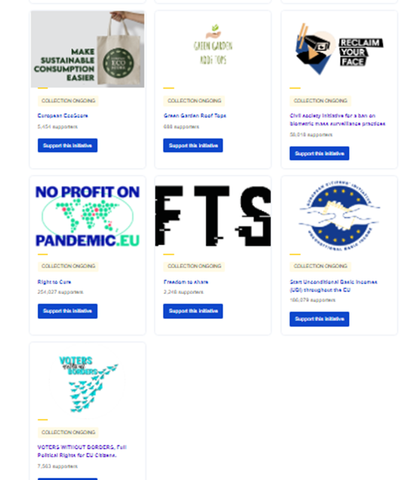
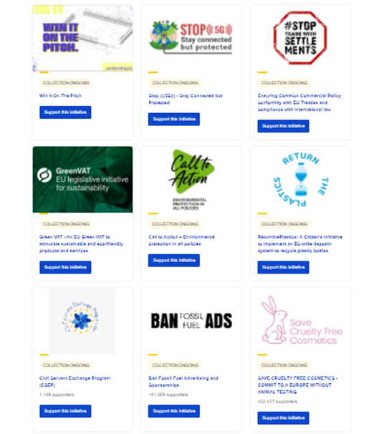
Ongoing Initiatives
Discover ongoing initiatives with CitizenCentral podcast!

Slide 18
Q&A

Slide 19
Why choose the European Citizens’ Initiative to take action at EU level?
Q&A with ECI organisers

Slide 20
ECI organisers on the call
Marina Konstantinidi, representing ‘ReturnthePlastics’
Michele Gianella, representing ‘Start Unconditional Basic Income (UBI) throughout the EU’
Elsa Kraemer, representing ‘European ECOScore’
Olga Kikou, representing ‘End the Cage Age’

Slide 21

Return The Plastics
Implementation of a Deposit Return System
for Plastic Bottles in the EU

Slide 22
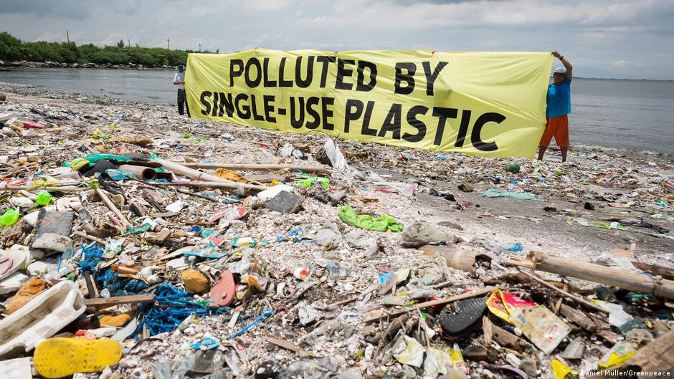
Why
#ReturnthePlastics ?

Slide 23
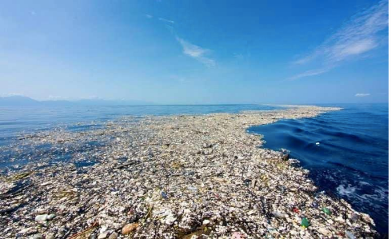

GREAT PACIFIC
GARBAGE PATCH
an island of floating plastic in the Pacific Ocean with 80.000 tons of plastic.
MICROPLASTICS
tidal waves break the plastics into smaller pieces overtime, fish eat it which is how microplastics end up on our plate.

Slide 24



Our Goal
To implement an EU-wide deposit-system
to recycle plastic containers
To encourage all EU Member states to call on supermarkets (chains) selling beverage containers to install reverse vending machines
To make companies that produce beverage containers
pay taxes for the recycling system
(under the polluter-pays principle)

Slide 25
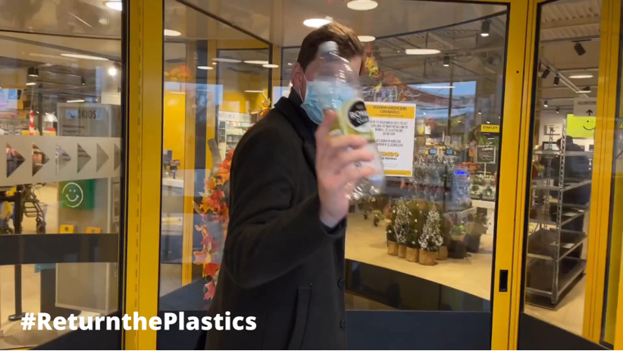
How DRS works
Start >>
Notes:
https://drive.google.com/file/d/1A9HS26xElowdd5wx6-J4AWNL9bwVUr_i/view

Slide 26
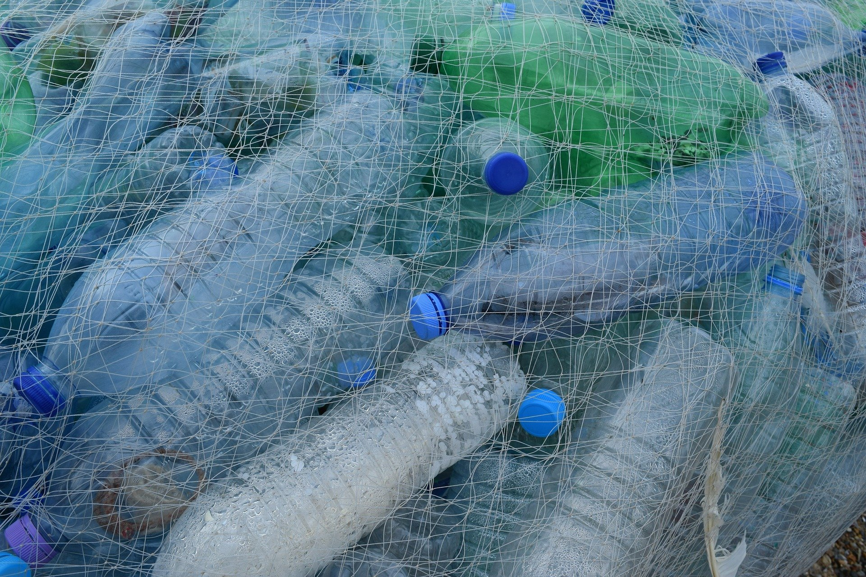
DRS Benefits
ENVIRONMENTAL
HUMAN HEALTH
COST SAVINGS
Reuse systems introduce a circular model and dramatically reduce plastics entering the environment.
The health impacts caused by leakage of harmful chemicals from plastics into food, beverages & environment can be avoided.
Reuse systems can decrease costs made in terms of waste management and litter collection for governments and relevant industries.

Slide 27
98%
95%
92%
of pet bottles in Germany are returned by consumers
of large pet
bottles in the Netherlands are returned by consumers
of pet bottles in Finland are returned by consumers

Slide 28
13 AUGUST 2021
19 NOVEMBER 2022
ECI registered for #Returntheplastics
Can we reach 1 million signatures?

Slide 29
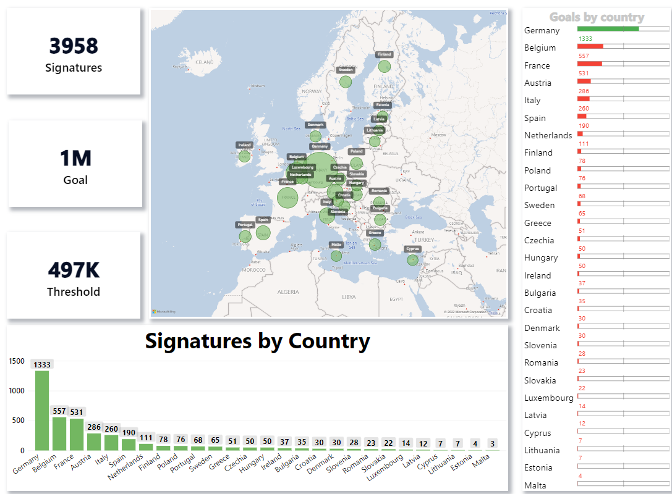
Your support until now

Slide 30
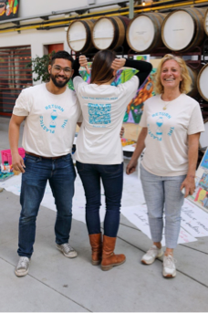
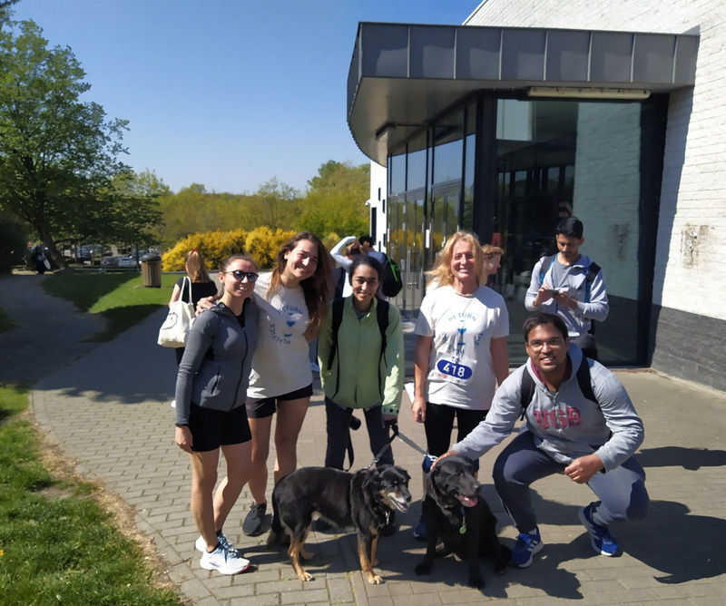
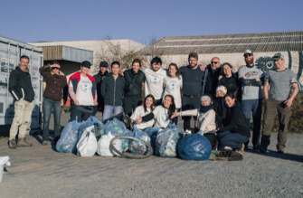
Actions
Greenpeace 50 years
anniversary.
Run for science.
Ghent river clean-up.

Slide 31


Join us & sign our ECI
Find us on
http://returntheplastics.eu/
Our ECI
https://eci.ec.europa.eu/020/public/#/screen/home
@return_the_plastics
@returntheplastics
@returnplastics
Notes:
http://returntheplastics.eu/
https://eci.ec.europa.eu/020/public/#/screen/home
https://www.facebook.com/returntheplastics
https://www.instagram.com/return_the_plastics/
https://twitter.com/ReturnPlastics

Slide 32
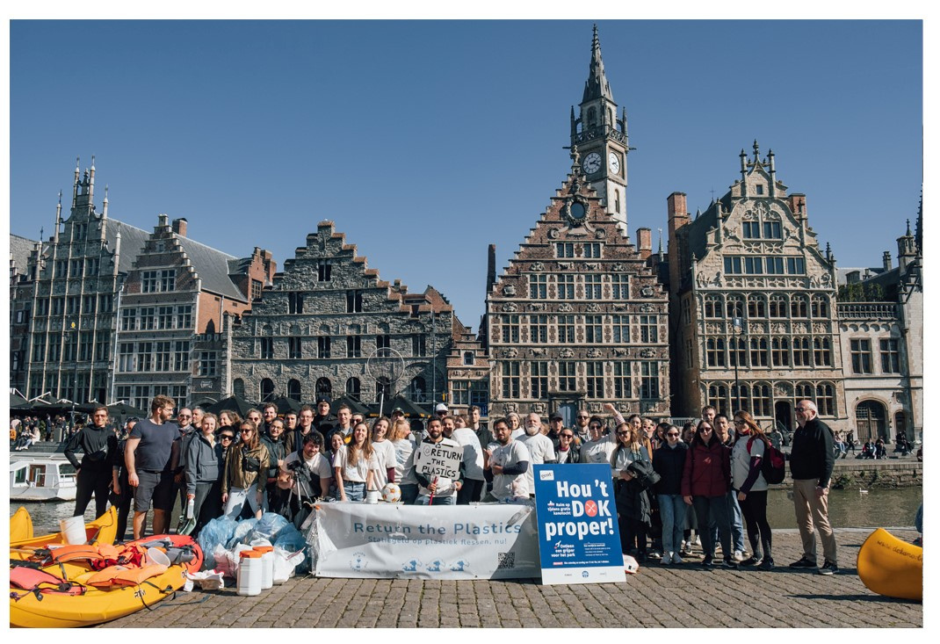
Thank you for listening!

Slide 33

Start Unconditional Basic Incomes throughout the EU, presented by Michele Gianella, Italian National Coordinator
Our aim is to establish the introduction of unconditional basic incomes throughout the EU which ensures every person's material existence and opportunity to participate in society as part of its economic policy.
The aim shall be reached while remaining within the competences conferred to the EU by the Treaties.

Slide 34
Start Unconditional Basic Incomes throughout the EU, presented by Michele Gianella, Italian National Coordinator
Objectives:
We request the EU Commission to make a proposal for unconditional basic incomes throughout the EU, which reduce regional disparities in order to strengthen the economic, social and territorial cohesion in the EU.
This shall realise the aim of the joint statement by the European Council, the European Parliament and the European Commission, stated in 2017, that "the EU and its member states will also support efficient, sustainable and equitable social protection systems to guarantee basic income" in order to combat inequality.

Slide 35
Start Unconditional Basic Incomes throughout the EU, presented by Michele Gianella, Italian National Coordinator
We have "National Coordinators" in 25 countries:
AT, BE, BG, CZ, DE, EE, DK, FI, FR, EL, HR, HU, IE, IT, MT, LT, LU, LV, NL, PT, RO, SK, SI, ES, SE
only in Cyprus and Poland "National Coordinators" are not yet available.
Signatures from all 27 Member States (2 May 2022): 213.027
Collection began 25 September 2020 (extended from 1 year to 1 year + 9 months due to Covid-19-Pandemic) and ends 25 June 2022

Slide 36
Start Unconditional Basic Incomes throughout the EU, presented by Michele Gianella, Italian National Coordinator
Milestones and meetings
25th September 2020 – Start
1st May 2022 – Basic Income Day
9th May 2022 – Europe Day – “ECI Sign Day”
26th to 28th September – BIEN Congress 2022
19th to 25th September 2022 – 15th International Basic Income Week
Bi-monthly: European Coordination Meetings (ECMs)
Regularly: meetings of ECI Coordination Team (CTMs)

Slide 37
Start Unconditional Basic Incomes throughout the EU, presented by Michele Gianella, Italian National Coordinator
Cooperation with other ECIs
ECI 'Actions on Climate Emergency' (from 'Fridays for Future')
ECI 'Voters Without Borders'
ECI 'Freedom to share'
Cooperation with other ECIs
EUMANS: a pan-European political citizens movement aimed to engage Europeans through democratic initiatives toward common goals for a better life in Europe through a more lively European democracy. Initiating the ECI Sign Day (Europe Day, 9 May 2022)
'Citizens take over Europe' and 'We move Europe'

Slide 38
Start Unconditional Basic Incomes throughout the EU, presented by Michele Gianella, Italian National Coordinator
Contacts for ECI organiser group:
Klaus Sambor klaus.sambor@aon.at
Ronald Blaschke blaschke@grundeinkommen.de
Official EU-website:
http://ec.europa.eu/citizens-initiative/public/initiatives/open/details/2020/000003
Our website: https://eci-ubi.eu
Facebook: https://www.facebook.com/ECIUBI
Twitter: https://twitter.com/eciubi
Instagram: https://www.instagram.com/eciubi/

Slide 39


In a nutshell
European EcoScore: a label with letters from A to F for all products sold in the EU
Assess environmental impact of products
European Citizens’ Initiative
+80 young people
+10 European countries

Slide 40
Why this Initiative? presented by
Elsa Kraemer, substitute representative
Willingness to act for the climate, after the climate strikes
Give a voice to young people
Consumption: an everyday act that has a big impact
Our objective : not to moralize, but to give consumers the tools to make conscious choices

Slide 41

Why a EUROPEAN EcoScore?
Raise awareness about environmental impact of products
Multitude of labels → unclear for consumers
Need of such a transparent and standardised label for the whole European continent
Large-scale action = more efficient to tackle climate crisis

Slide 42
Specific needs
Reach bigger actors
Increase number of citizens talking about it
Financing and partnerships

Slide 43
The European EcoScore team
+ 80 other team members
Coming from more than
10 EU countries!

Slide 44


Thank you!
Feel free to ask any questions and to contact us!
@eu.ecoscore
European EcoScore
eu.ecoscore@gmail.com

Slide 45

End the Cage Age, presented by
Olga Kikou, Head of Compassion in World Farming EU
Over 300 million farmed animals suffer in cages across Europe. This is cruel, unnecessary and has no place in Europe in the 21st century.
Our movement seeks to end the use of cages in animal farming.

Slide 46
Why did we choose the ECI to take action?
We chose the ECI instrument for the following reasons:
• To increase awareness among EU citizens
• To mobilise people across the EU in support of animals
• To achieve a significant response from the EU institutions
• To ensure that any commitments would have an EU-wide reach

Slide 47
What have we achieved so far?
The hard work spanning the course of 3 years has culminated in a major victory, starting with the EU Parliament and following with the historical decision by the European Commission on June 30, 2021 to revise current EU legislation with a commitment to:
• Put forward a legislative proposal before the end of 2023 to phase out and finally prohibit the use of cages for hens, mother pigs, calves, rabbits, ducks, geese, quails and other farmed animals​
• Consider the phase out the use of cages for farmed animals across Europe by 2027​
• Ensure that all imported products in the EU comply with future cage-free standards​
• Examine providing incentives and financial support to European farmers during the transition to cage-free farming​
​

Slide 48
Diving deeper with the ECI Forum
Tips and tricks to make the most of your ECI experience
Elisa Lironi, Programme Director for European Democracy, European Citizen Action Service

Slide 49

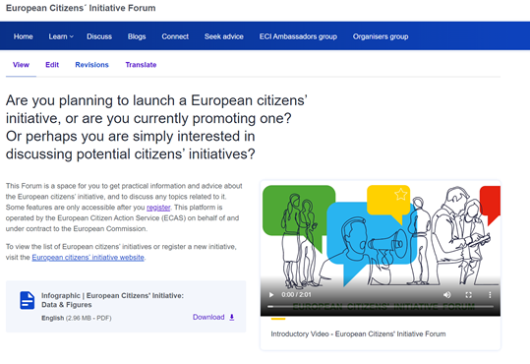
A great tool for organising your initiative
Learn Section: Webinars, Guidance Notes, Learning Material
Blogs
Discuss
Seek Advice: if you need campaigning or fundraising advice during your campaign
* You must register to access certain features of the ECI Forum
The ECI Forum

Slide 50

An essential tool for (potential) organisers where you are able to get practical information, advice and discuss any topics related to ECIs
Aim = support active citizen participation
The ECI Forum

Slide 51

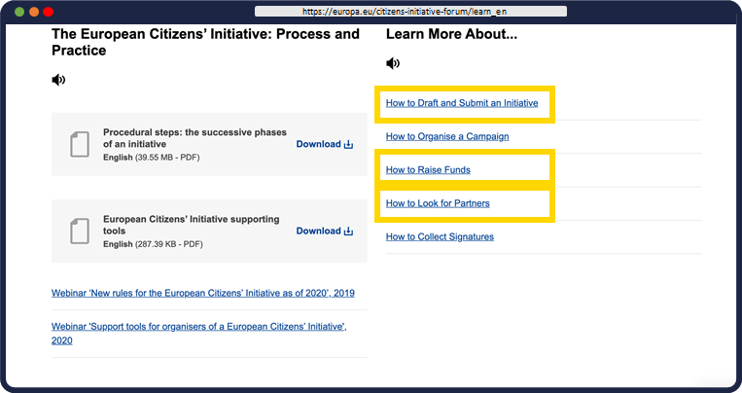
LEARN
The ECI Forum
Webinars
Guidance Notes
Success Stories
Testimonies

Slide 52

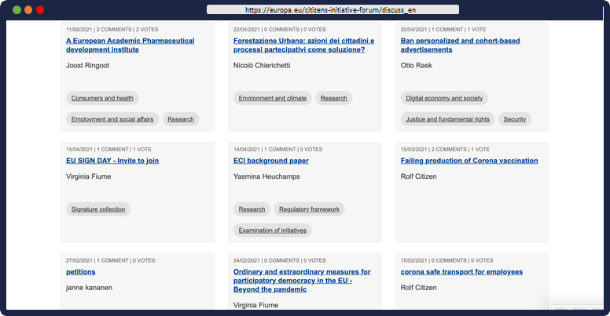
DISCUSS
The ECI Forum

Slide 53
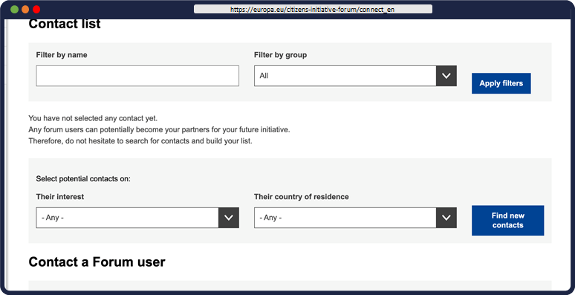

CONNECT
The ECI Forum

Slide 54

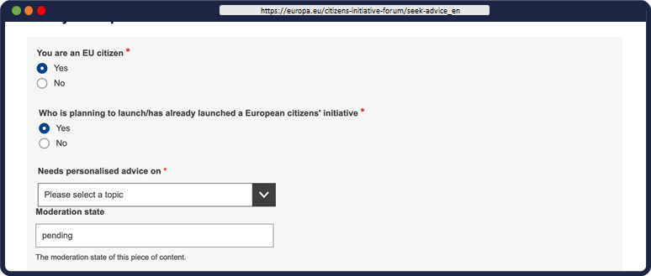
SEEK ADVICE
The ECI Forum
Legal
Campaigning
Fundraising
Other...

Slide 55
Online course
Learn more about the European Citizens' Initiative by joining our online course:
• https://academy.europa.eu/courses/essential-skills-for-european-citizens-initiative-organisers
The ECI Forum

Slide 56
Some more questions...

Slide 57
Find out more & stay in touch
ECI website: https://europa.eu/citizens-initiative/
ECI Forum website: https://europa.eu/citizens-initiative-forum/
Subscribe to the monthly newsletter (EN/FR/DE): https://europa.eu/citizens-initiative/newsletter/subscribe_en
Subscribe to CitizenCentral Podcast: https://europa.eu/citizens-initiative/citizencentral-podcast_en
Local contacts: ECI Ambassadors and National Contact Points
Notes:
EU Sign Day (9 May) and join activities in your country for Europe Day (stand in Brussels on Saturday).

Slide 58
Thank you!
Please take our survey (link in chat!)

