Slide 1
EU DEMOCRACY
IN ACTION
Have Your Say with the
European Citizens'
Initiative
Unit 1
A Brief introduction to the EU

Slide 2


Slide 3


Slide 4




EU
Values
“
‘The Union is founded on the values of respect for human dignity, freedom, democracy, equality, the rule of law and respect for human rights, including the rights of persons belonging to minorities. These values are common to the Member States in a society in which pluralism, non-discrimination, tolerance, justice, solidarity and equality between women and men prevail.’
Article 2 of the Lisbon Treaty
Freedom
Human dignity
Freedom
Equality
Democracy
Rule of law
Human rights
Human rights

Slide 5
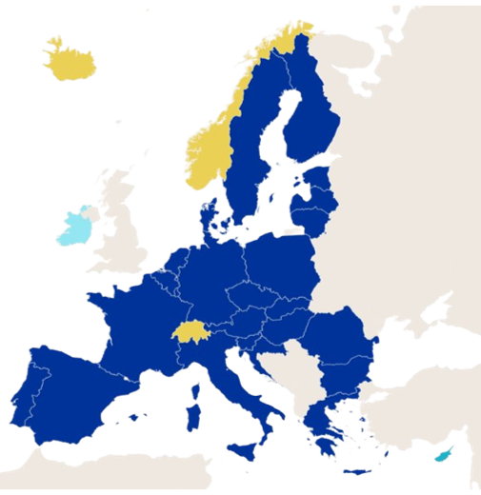

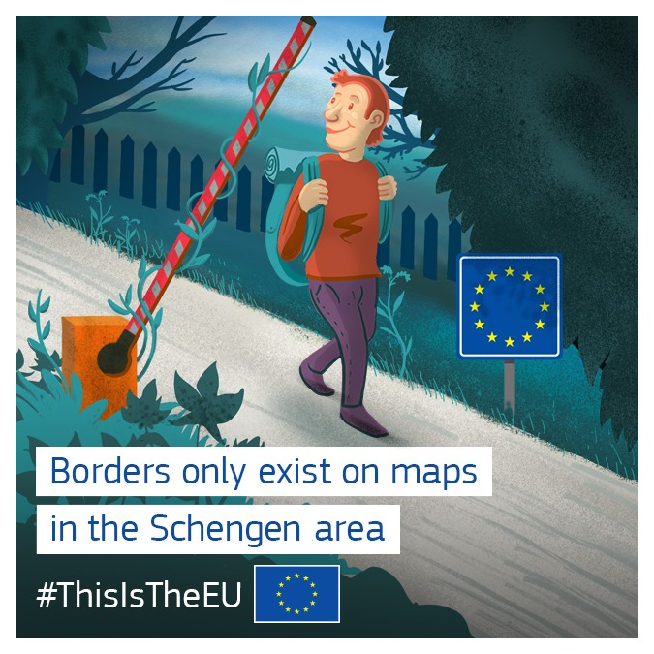
The Schengen Area
29
countries*
Common
visa policy
for external visitors
*As of 1 January 2025
No borders between members

Slide 6
Current
Members of the
Schengen Area
13
8
21
28
7
1 Austria
2 Belgium
3 Bulgaria
4 Croatia
5 Czechia
6 Denmark
7 Estonia
8 Finland
9 France
10 Germany
11 Greece
12 Hungary
13 Iceland
14 Italy
15 Latvia
15
16 Liechtenstein
17 Lithuania
18 Luxembourg
19 Malta
20 the Netherlands
21 Norway
22 Poland
23 Portugal
24 Romania
25 Slovakia
26 Slovenia
27 Spain
28 Sweden
29 Switzerland
6
17
20
22
2
10
18
5
25
16
1
12
9
29
26
4
24
14
3
23
27
11
19

Slide 7
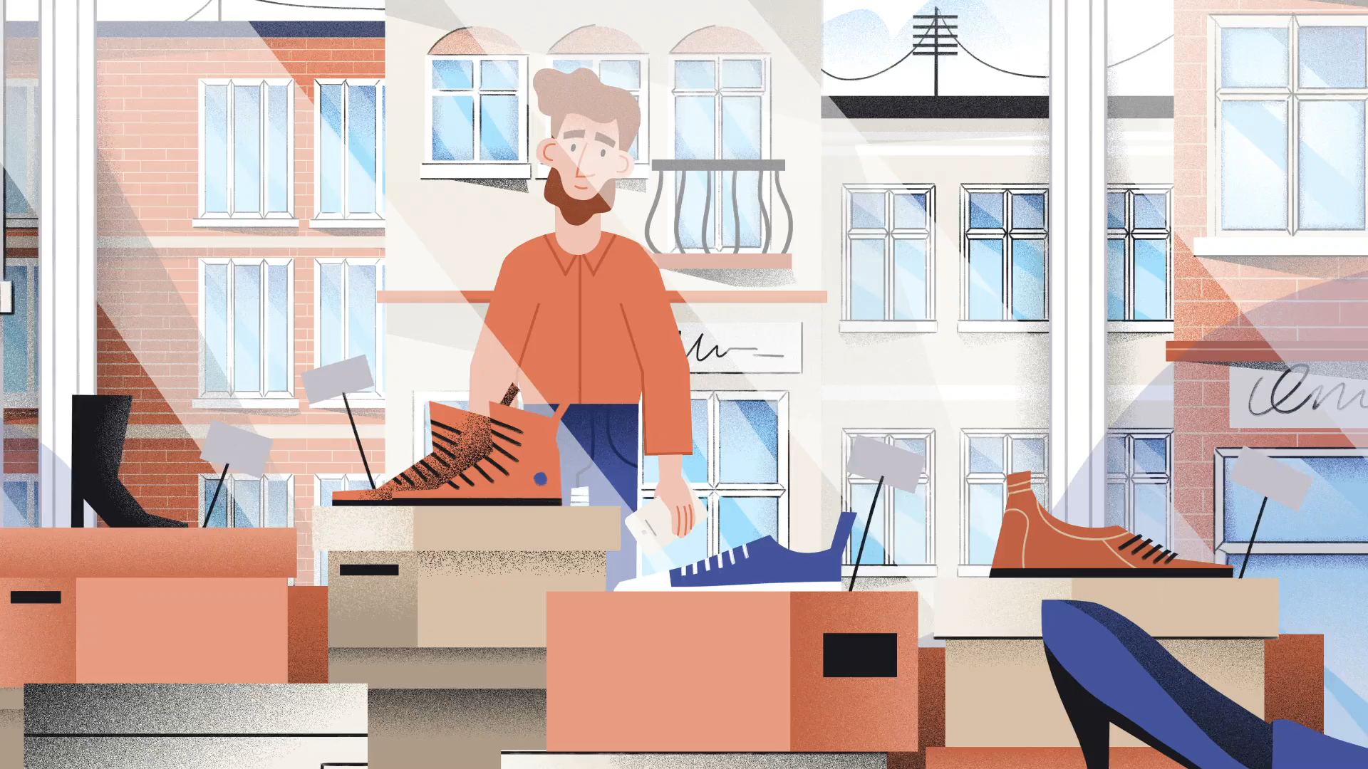

Slide 8

The Single Market and Customs Union
Goods
Capital
Free
movement
of:
People
Services

Slide 9
What can the EU make laws about?
Customs union
Single market
Transport
Migration and home affairs
Competition rules
Employment and social affairs
Trans-European networks
Public health
Monetary policy
Agriculture
Energy
Research and space
Trade
Fisheries
Justice
Development cooperation and humanitarian aid
Marine plants and animals
Environment
Fundamental rights
Consumer protection

Slide 10
Areas where the EU can support national action
Public health
Civil protection
Industry
Administrative cooperation
Culture
Education and training, youth and sport
Tourism

