Slide 1
EU DEMOCRACY
IN ACTION
Have Your Say with the
European Citizens'
Initiative
Unit 2
Democracy in the EU

Slide 2


Two Types of Democracy
Representative:
‘A system of government in which citizens elect representatives who propose and vote on legislation or policy initiatives on their behalf’.
Participatory:
‘A system whereby citizens are involved in public decision-making processes, thus complementing representative democracy’.

Slide 3


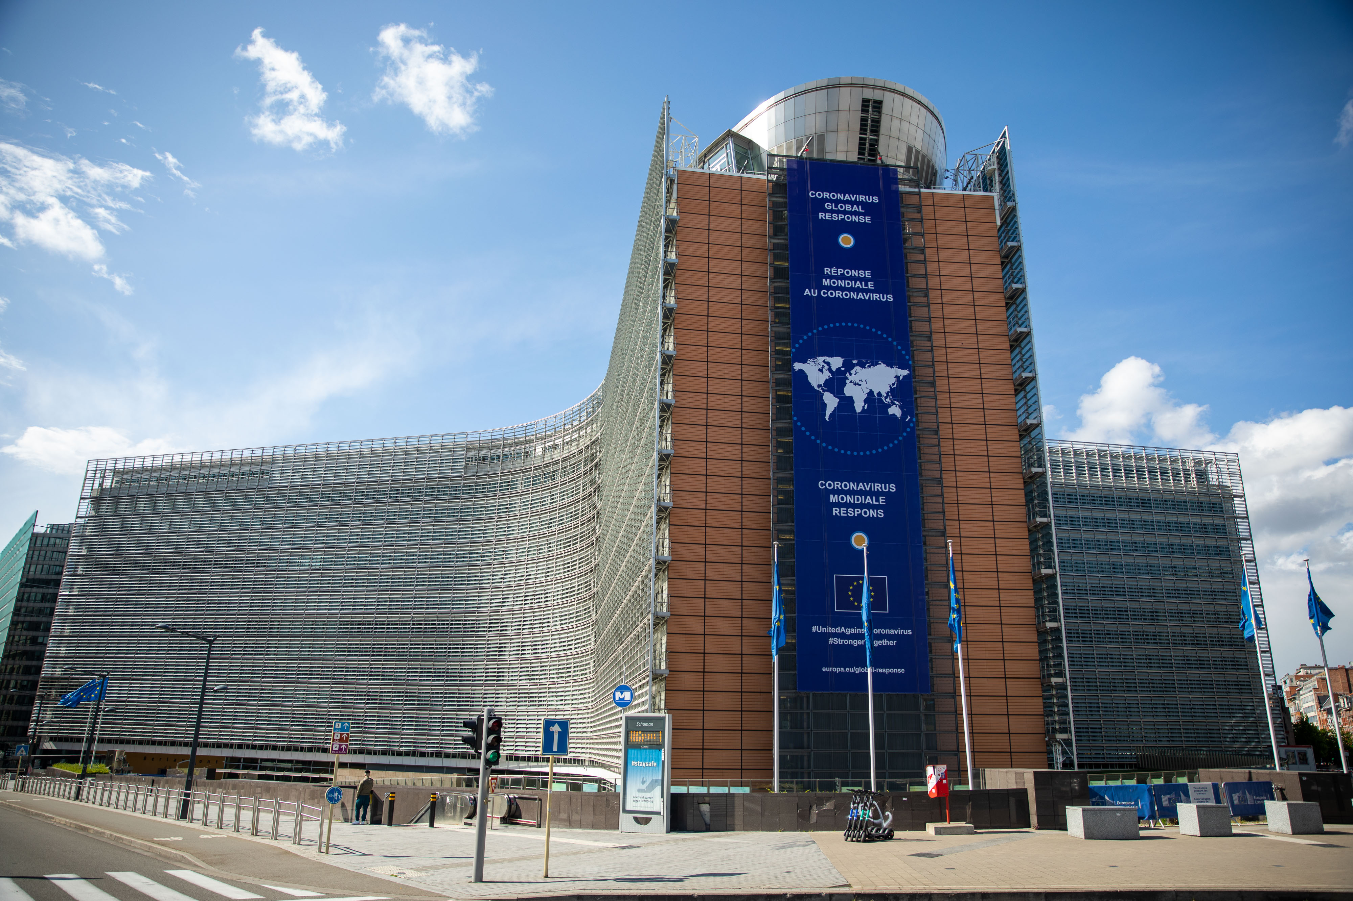
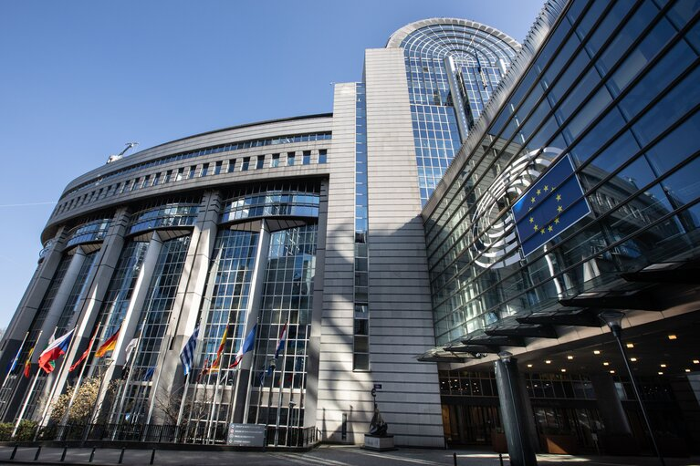
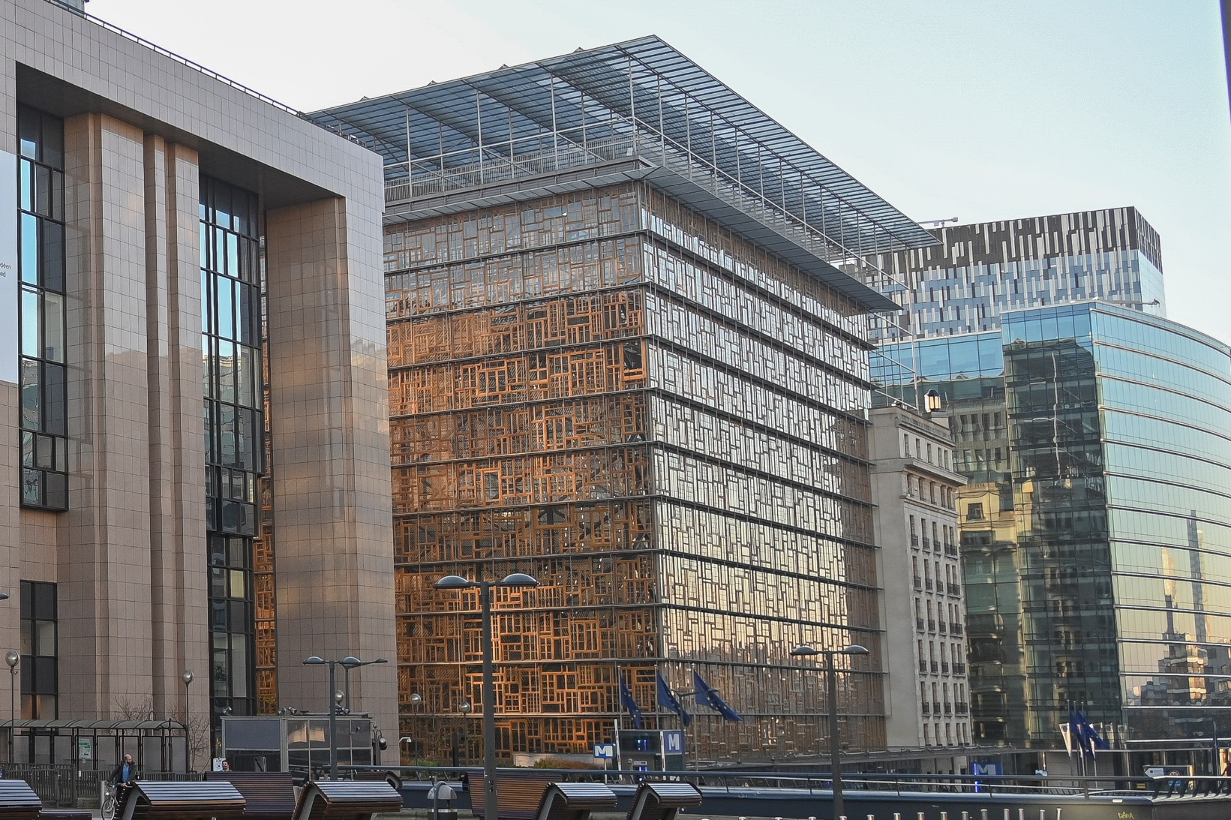
The Three Main EU Institutions

Slide 4
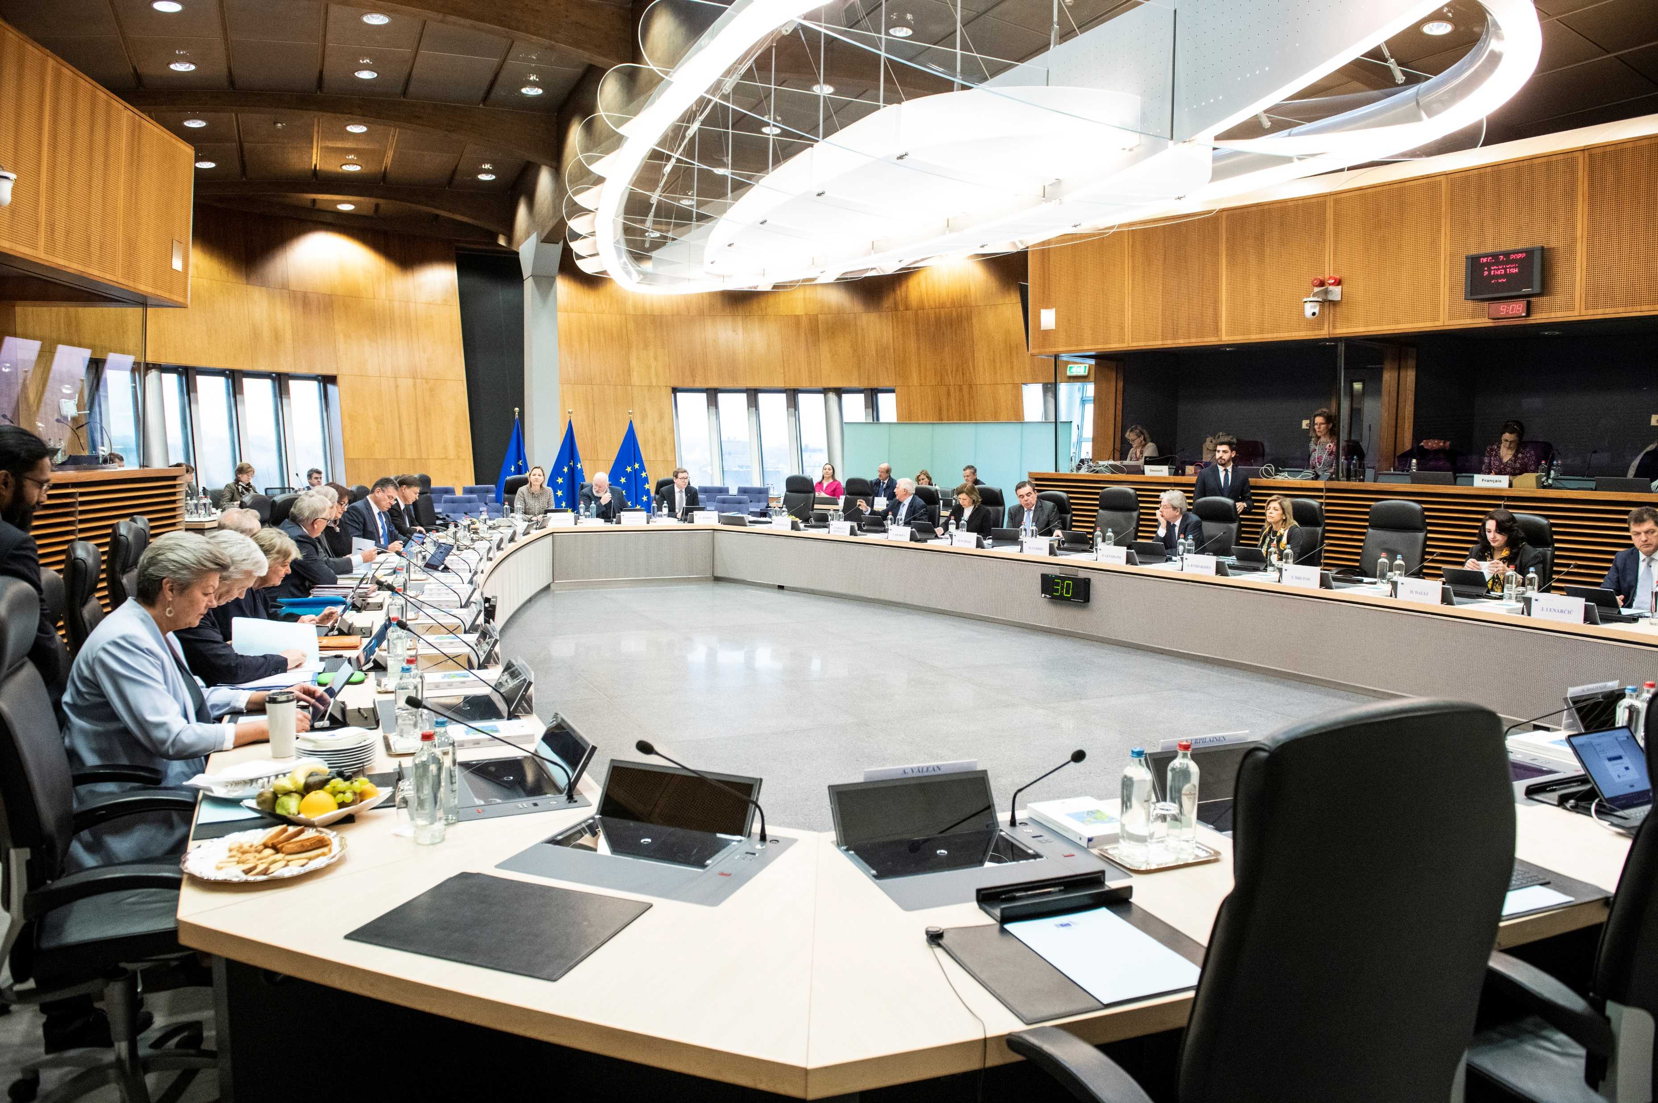
The European Commission
Represents the common interests of the EU
Proposes new EU laws
Consists of 27 Commissioners
(1 from each EU country)

Slide 5
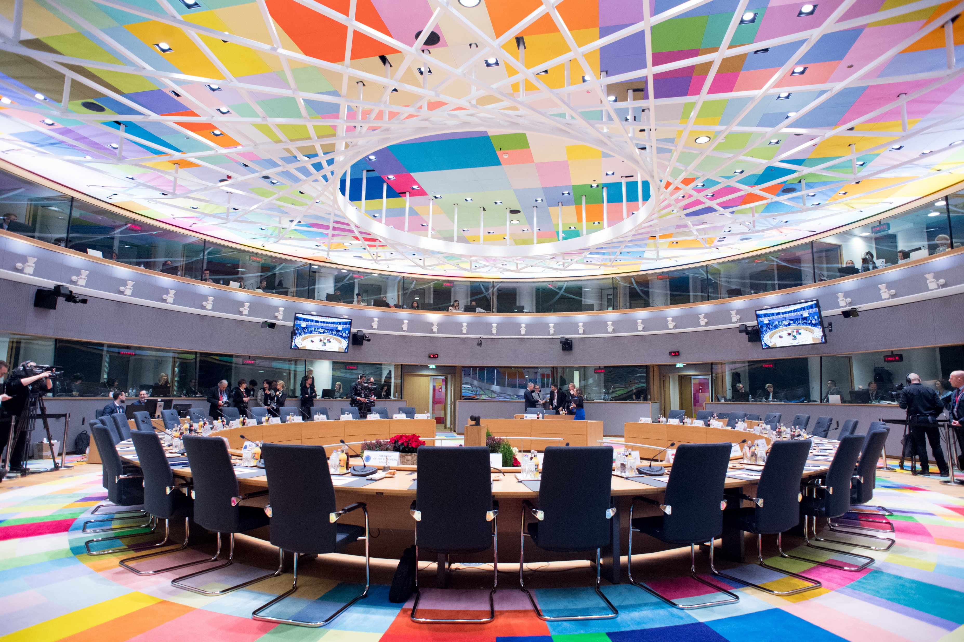
The Council of the European Union
Represents the governments of EU countries
Negotiates and adopts EU laws
Made up of ministers from each EU country

Slide 6


Slide 7
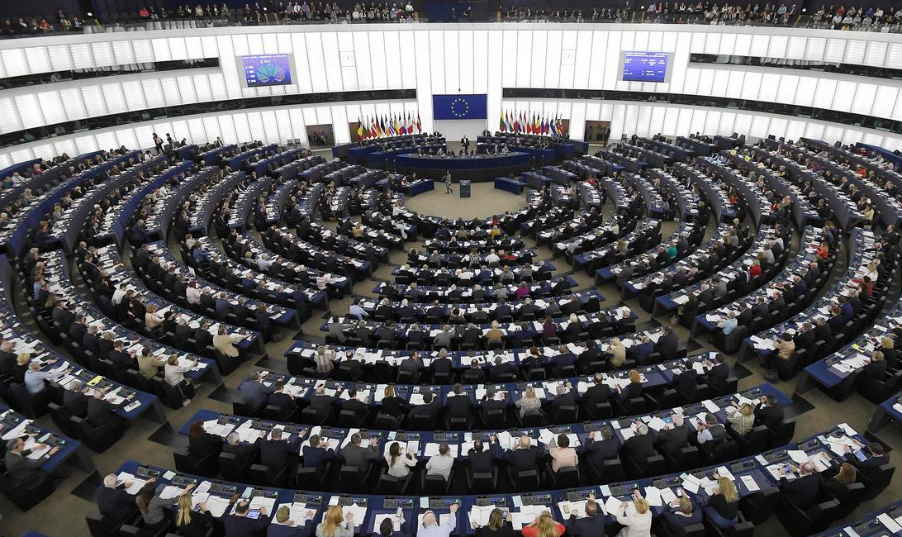
The European Parliament
Represents the citizens of EU countries
Negotiates and adopts EU laws
Directly elected by
EU citizens

Slide 8


Slide 9
How laws are made…
European COMMISSION
proposes legislation
Sent to
Parliament and Council
for discussion
European PARLIAMENT
COUNCIL OF THE EU
Both parties
discuss and can amend the proposal.
If they agree, the law is adopted.
Notes:
Please update graphics and animation.

Slide 10


