Slide 1
Discover the European Citizens’ Initiative
October 2022

Slide 2
What you can expect
Welcome and short quiz
Discover the ECI – what is the ECI and why does it matter?
What impact 10 years on?
Communicating about the ECI – what tools and channels are there? + ECI Forum
Are you ready to get involved?
Close @ 11:30

Slide 3
Discover the ECI – what is the ECI and why does it matter?
New ECI video: https://audiovisual.ec.europa.eu/en/video/I-231323

Slide 4
Participatory democracy: options at EU level
Vote or run as a candidate in European elections
European Citizens’ Initiative
EU Have Your Say Portal
Submit a petition to the European Parliament

Slide 5
Elevator pitch #1
When they ask: “What is the ECI?”
You can say: “The European Citizens’ Initiative is a participatory democracy tool that gives EU citizens the right to have a say in EU policies that affect them
EU citizens have the right to sign any open citizens’ initiative or start one
A group of 7 EU citizens can propose a change they want to see in the EU, then they have 1 year to collect 1 million signatures of support
If 1 million valid signatures are reached – you meet with lawmakers and get an official response from the European Commission
Citizens’ initiatives must meet certain criteria*
Notes:
Citizens can suggest concrete legal changes in any field where the European Commission has power to propose legislation; not be harmful/discriminatory ..
*You call on the European Commission to propose new EU legislation in an area where the EU has the power to act. (EU competences and Commission powers)

Slide 6
Competences of the EU
Notes:
*You call on the European Commission to propose new EU legislation in an area where the EU has the power to act. (EU competences and Commission powers)

Slide 7
The ECI in action – 6 Steps to turn an idea into a citizens’ initiative

Slide 8
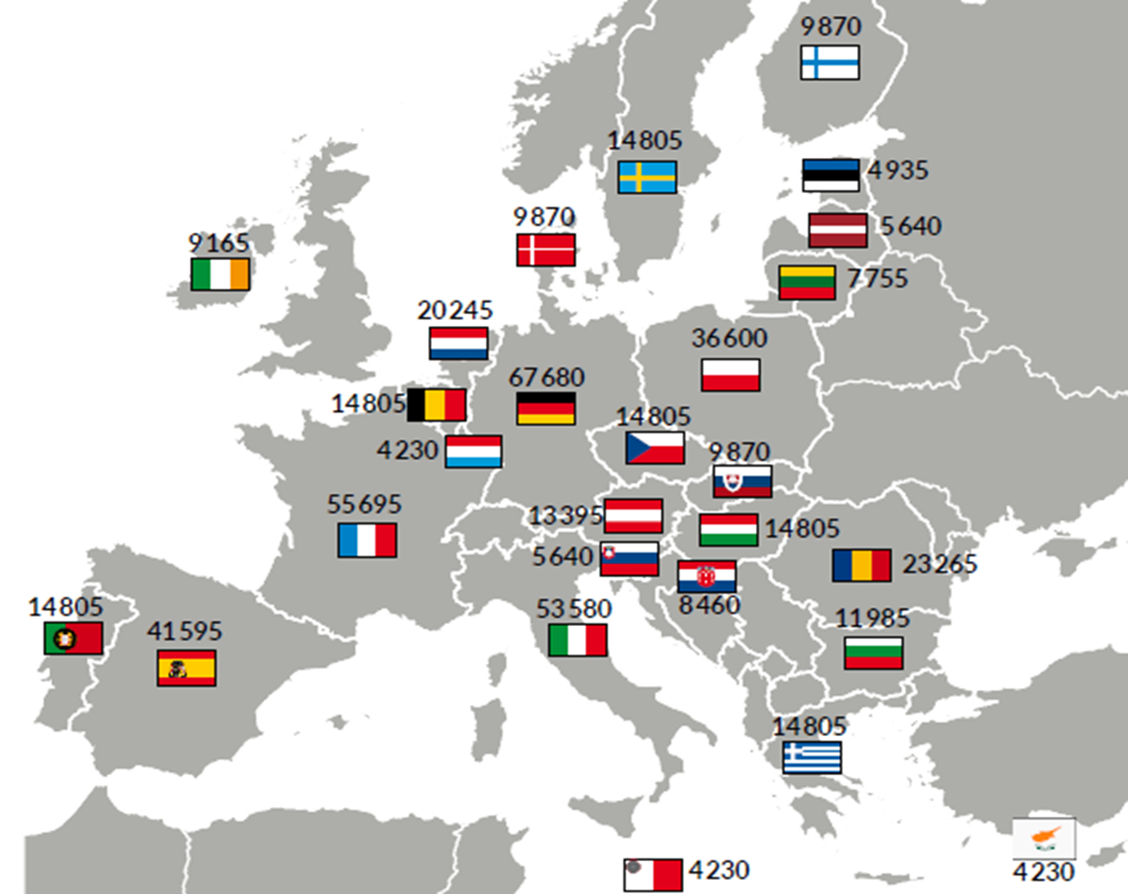
Thresholds to reach in at least 7 countries

Slide 9
Elevator pitch #2
When they ask: “Why should I care about the ECI?”
You can say:
The ECI brings new ideas that haven't been considered yet on the radar of EU and other policymakers
The ECI gives you and other EU citizens the right to take action on issues you care about – and you can help organisers by supporting their ideas

Slide 10
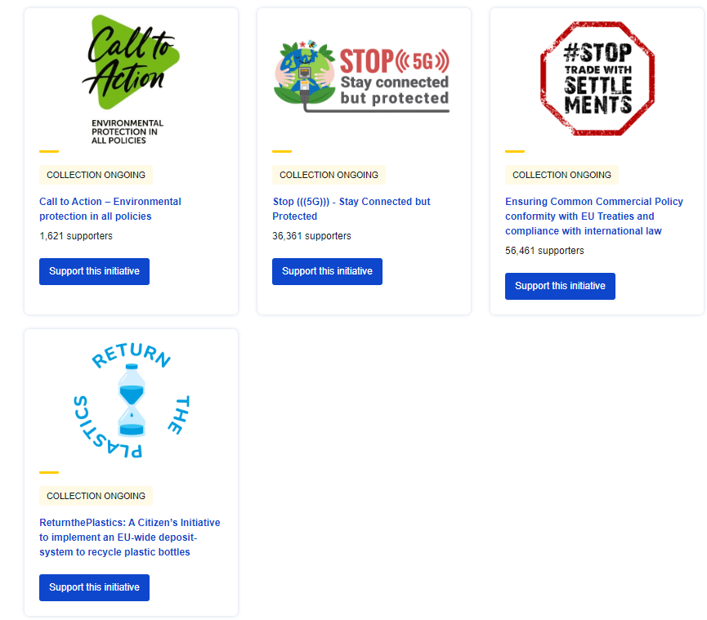
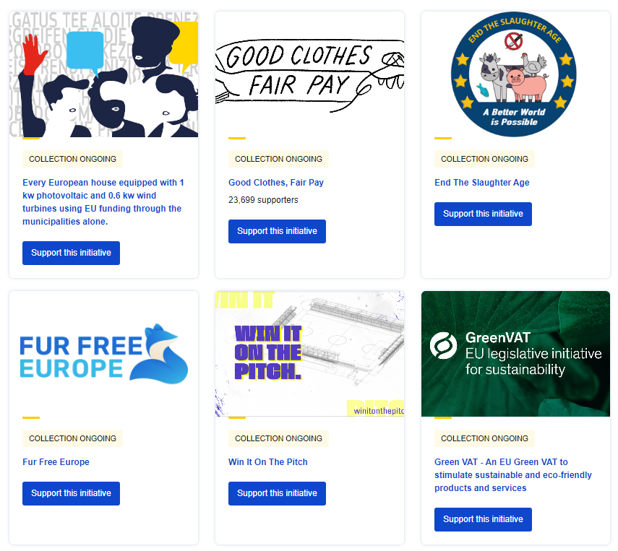
Ongoing Initiatives
Discover ongoing initiatives with CitizenCentral podcast!

Slide 11
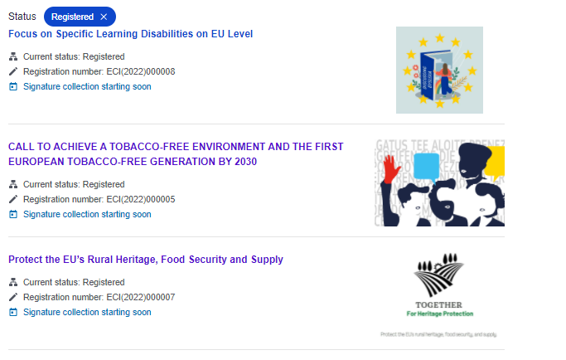
New registered initiatives

Slide 12
Elevator pitch #3
When they ask: “How can I get involved with the ECI?”
You can say: As an EU citizen, you can:
Sign an ongoing initiative
Support an initiative (volunteer time, promotion, etc.)
Start a new initiative

Slide 13
Elevator pitch #4
When they ask: “What can I achieve by starting/supporting an ECI?”
You can say: “The European Citizens’ Initiative helps bring causes you care about to the EU level.”
Spark a debate
Raise awareness
Trigger policy change in the EU

Slide 14
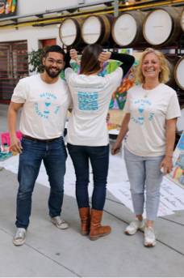
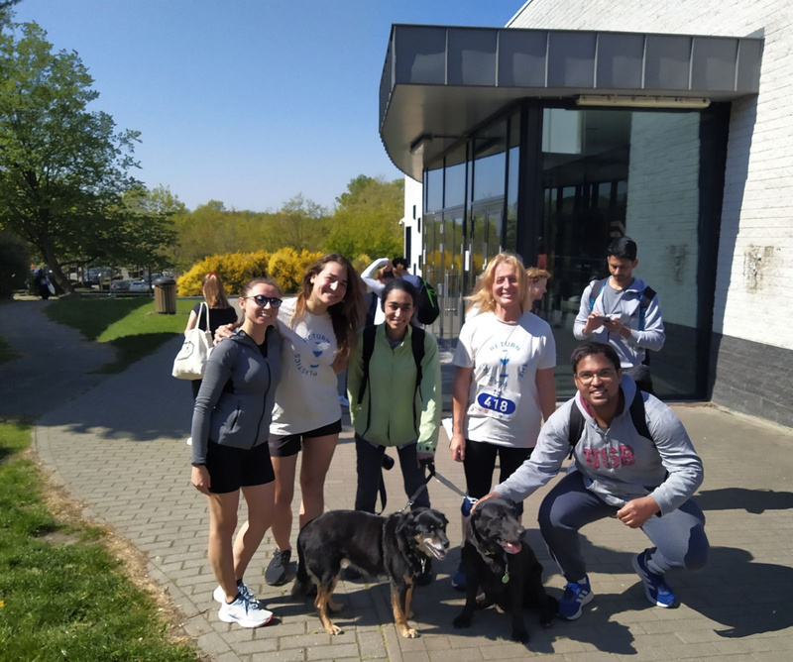
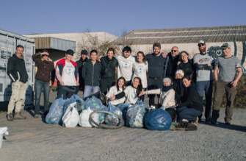
Real people taking real action
Greenpeace 50 years
anniversary
Run for science
Ghent river clean-up

Slide 15
What impact has the ECI made 10 years on? Key results, facts & figures

Slide 16
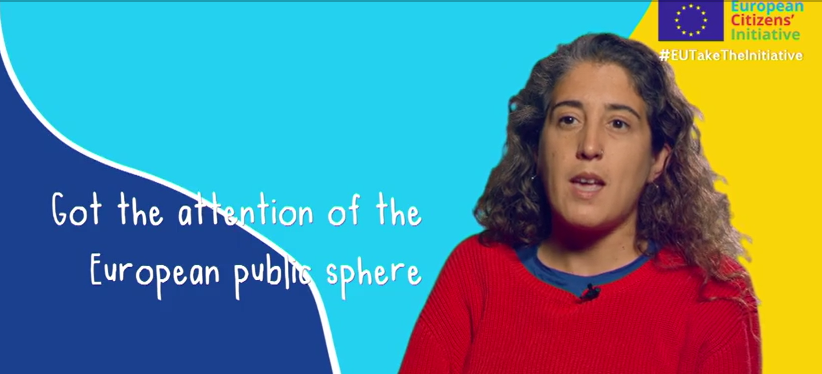
Facts & Figures – overview since 2012
95 initiatives registered
10 initiatives
collecting signatures
3 initiatives under verification
6 initiatives replied to by the EC
Notes:
Video: https://audiovisual.ec.europa.eu/en/video/I-214692?&lg=INT

Slide 17
Facts & Figures – overview since 2012
160 initiative organisers were under-30 when starting an ECI
800+ citizen organisers
17 million+
signatures
collected
2 in 5 Europeans know about the ECI

Slide 18
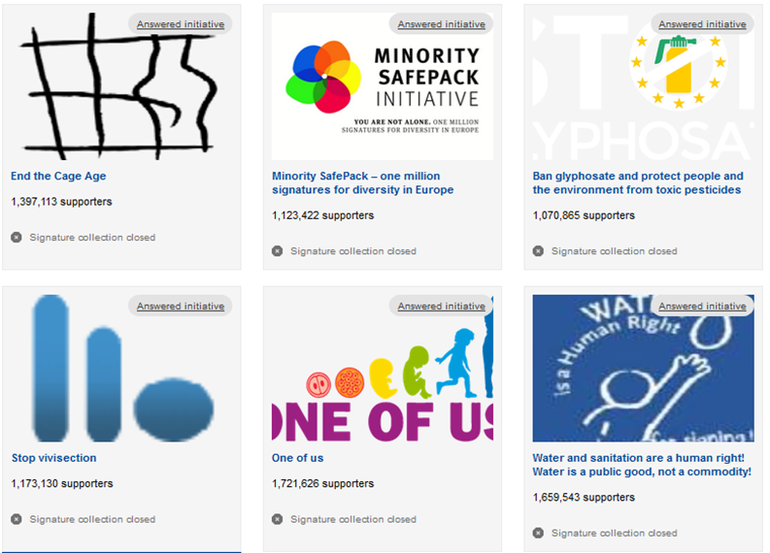
Successful Initiatives
Notes:
Save Bees and Farmers – submitted last week.

Slide 19
Elevator pitch #5
When they ask: “What impact has the ECI had?”
You can say: Thanks to the ECI...
Access to clean drinking water is protected in the EU (Right2Water)
Farm animals will be raised more humanely (End the Cage Age)
Authorisation processes of food-related products such as pesticides, additives or packaging materials are transparent; no more secret industry studies. (Ban glyphosate (..))
Sparking policy debate (ban biometric surveillance, healthy soils..)
Organising an Eci helps you build communication, negotiation, advocacy, etc. skills and expands your network

Slide 20
What tools are available to communicate about the ECI? And how you can get started!

Slide 21
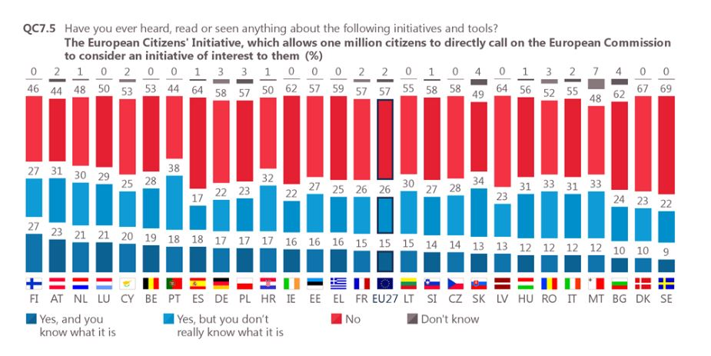
Notes:
If not already said: 447 million EU citizens > 17 mil. signatures collected

Slide 22
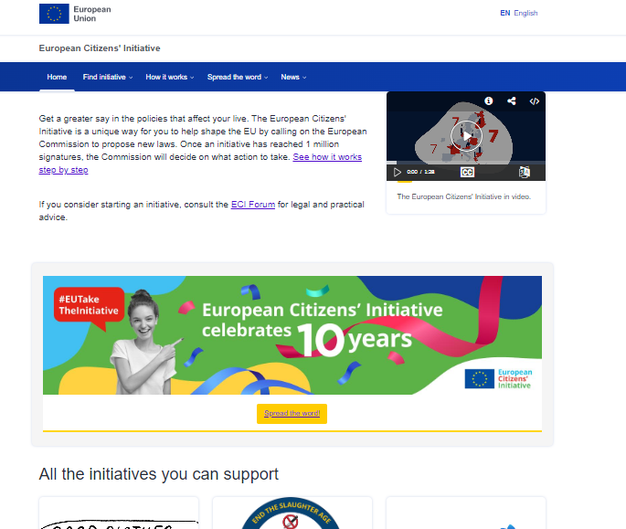
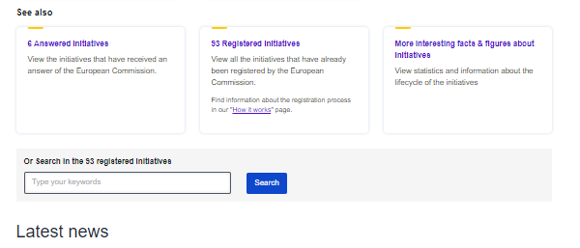
ECI multilingual website

Slide 23
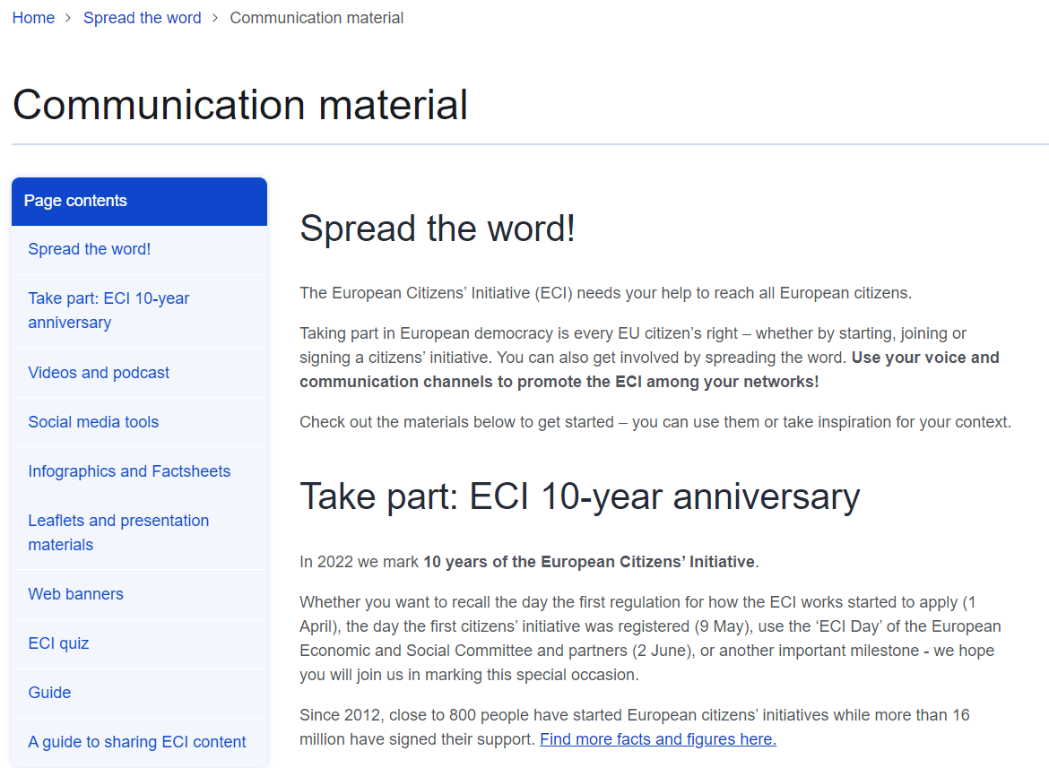

Slide 24
Overview of communication materials
Videos
CitizenCentral podcast and Medium article (EN-only)
Quiz!
Leaflets, postcards, guides, infographics…
Social media visuals and sample copies
Monthly newsletter (sent in EN + machine translation)
2023: Educational Module and competition
**Nearly all materials in 24 EU languages**
Notes:
Medium: https://europeancommission.medium.com/european-citizens-initiative-gave-europeans-a-real-say-with-students-young-people-e5c8c5571da

Slide 25
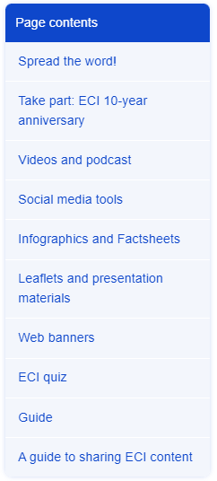
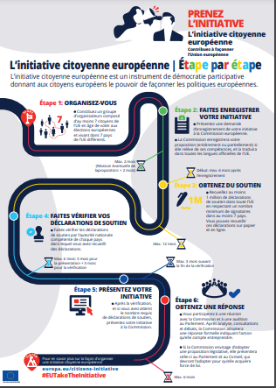
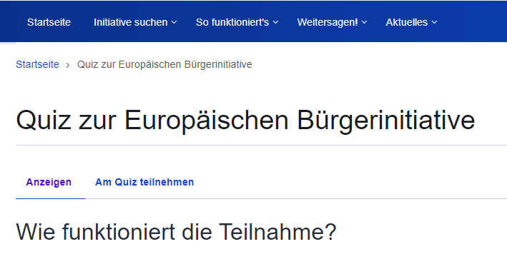
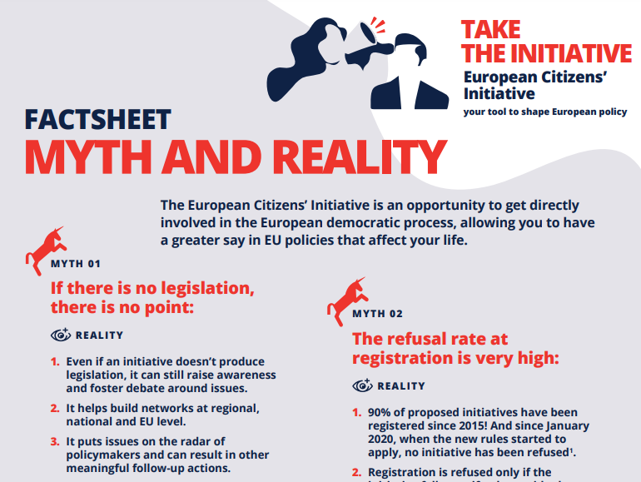
Sample multilingual materials

Slide 26
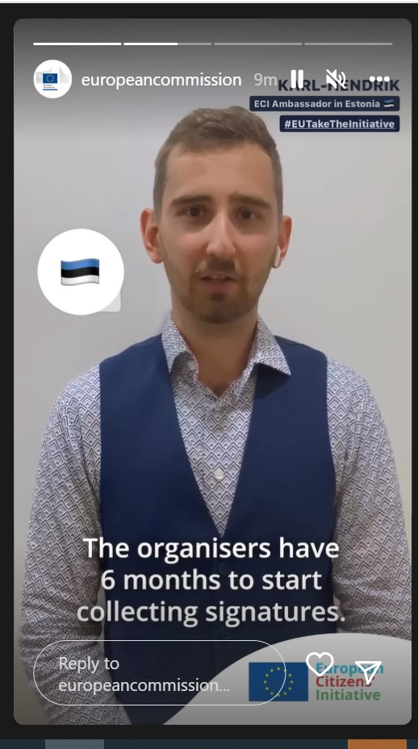
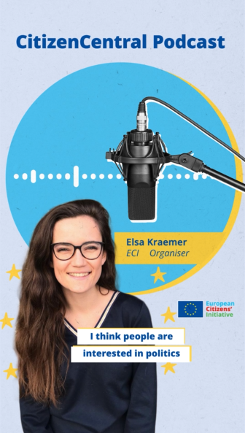
#EUTakeTheInitiative

Slide 27
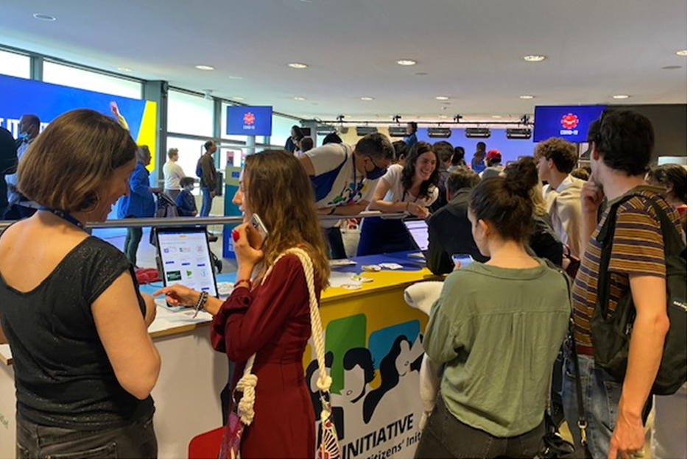
Events

Slide 28
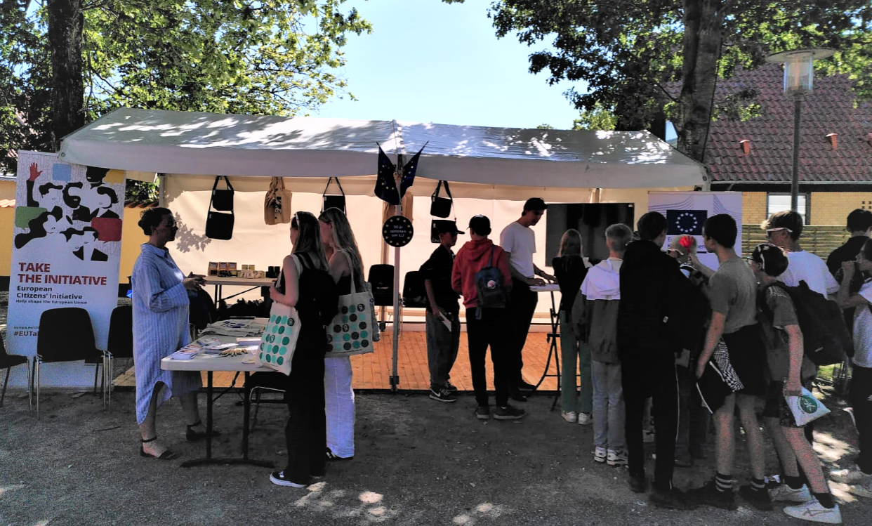
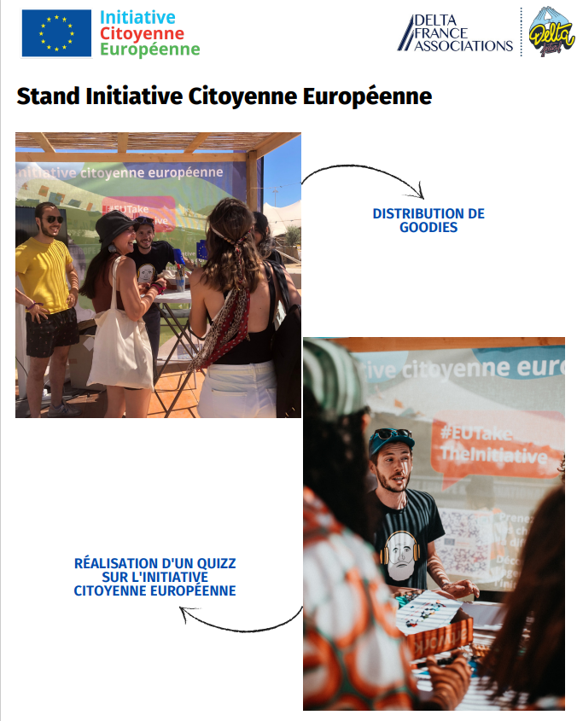
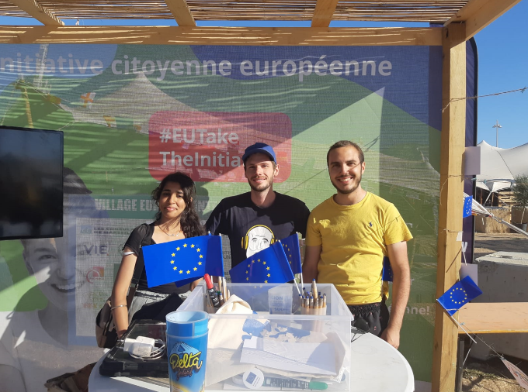
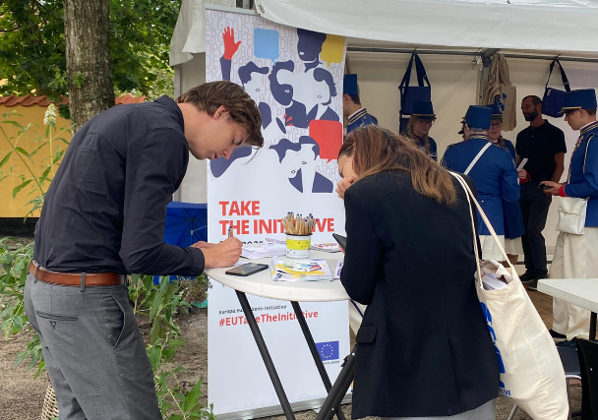

Slide 29
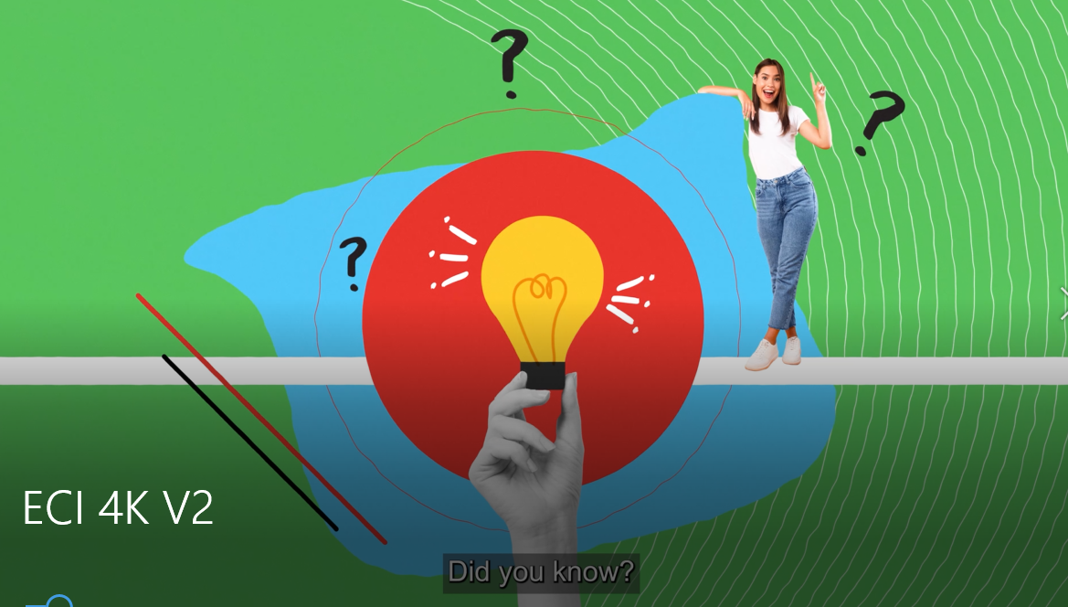
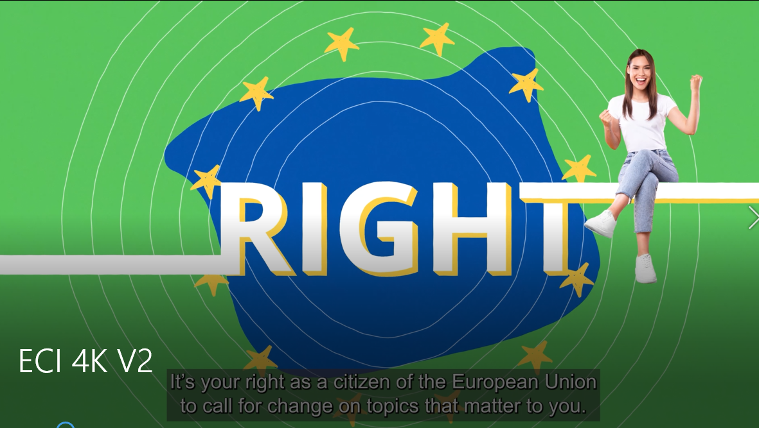
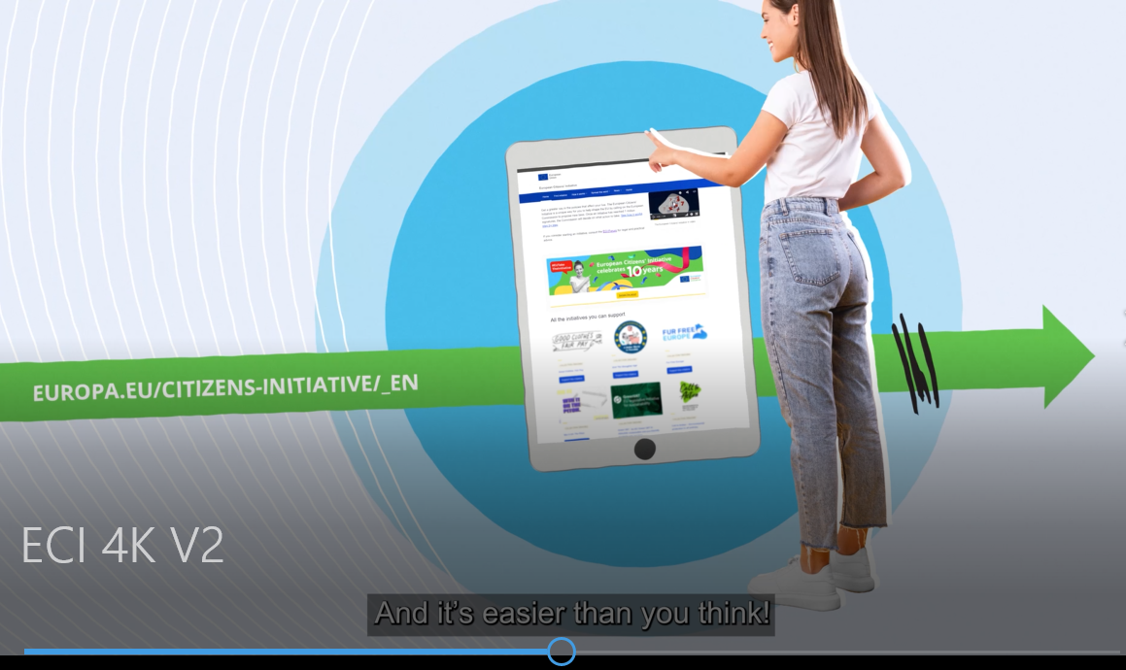
New video

Slide 30
In Focus
2023: Educational Module and competition
4 modules in all languages
Toolkits for teachers and students
Piloting: as of January 2023
Official launch: school year 2023-2024
Promoted via school competition

Slide 31
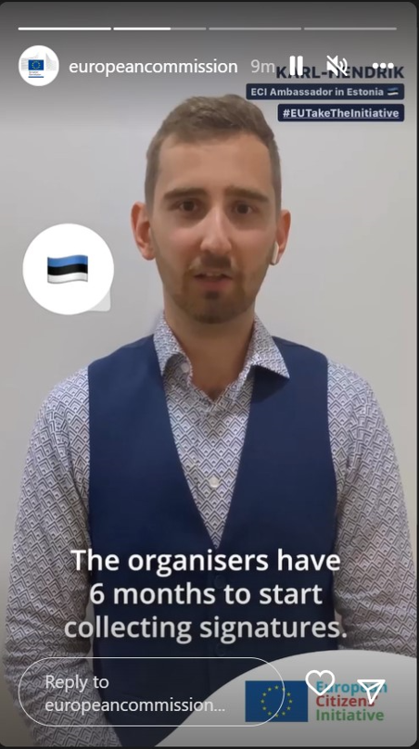
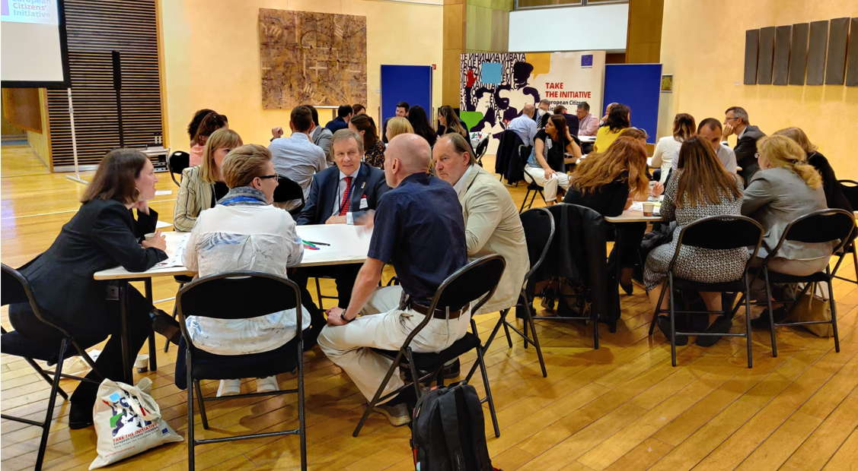
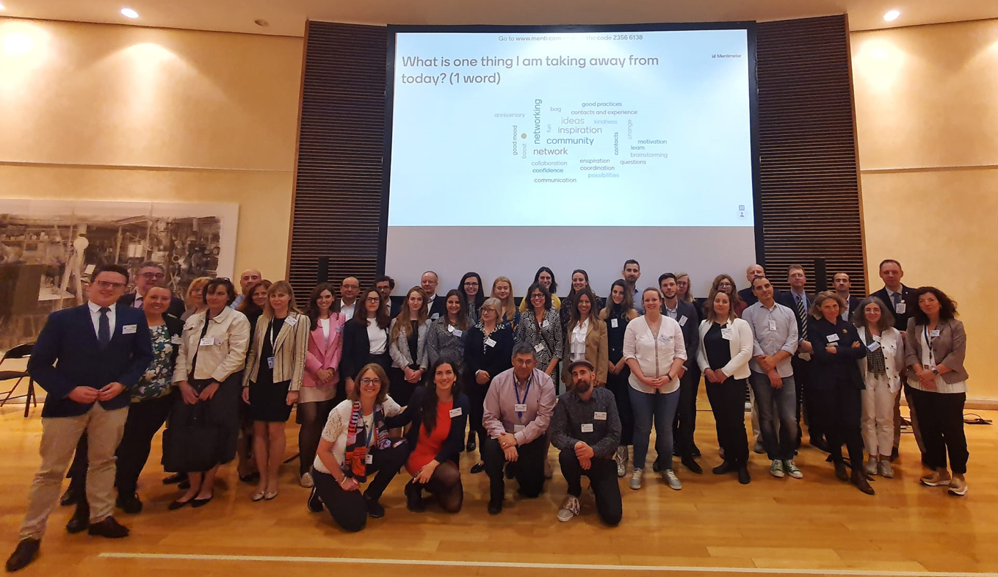
ECI Ambassadors

Slide 32
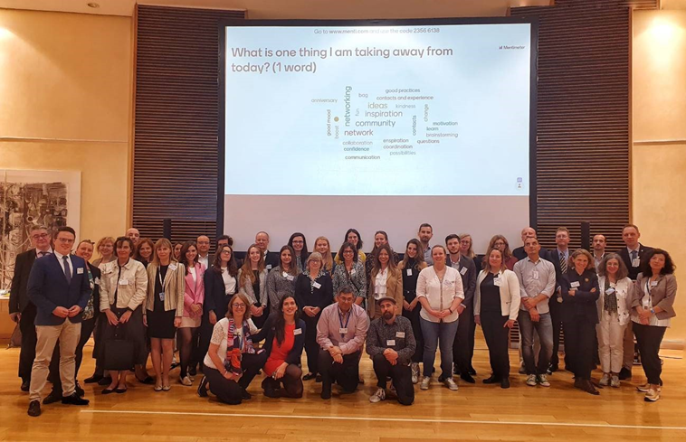
National Contact Points
Regulation 2019/788, Article 4(6): “Each Member State shall establish one or more contact points to provide, free of charge, information and assistance to groups of organisers, in accordance with applicable Union and national law.”
Role and activities of national contact points – report from ECI network gathering on 1 June 2022 (organised in conjunction with the ECI Day)

Slide 33
Vasiliki Mustakis, Participatory Democracy Coordinator, European Citizen Action Service
The European Citizens’ Initiative Forum
Notes:
https://europa.eu/citizens-initiative-forum/_en

Slide 34
The Forum supports organisers in the preparatory phase and during the collection of signatures of their initiative!
LEARN
DISCUSS
CONNECT
SEEK ADVICE

Slide 35
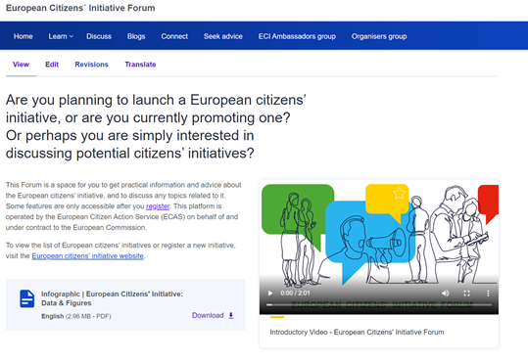
A great tool for organising an initiative
Learn Section: Webinars, Guidance Notes, Learning Material
Blogs
Discuss
Seek Advice: if an organiser needs legal, campaigning or fundraising advice during their campaign
* You must register to access certain features of the ECI Forum

Slide 36
An essential tool for (potential) organisers where they are able to get practical information, advice and discuss any topics related to ECIs Aim = support active citizen participation

Slide 37
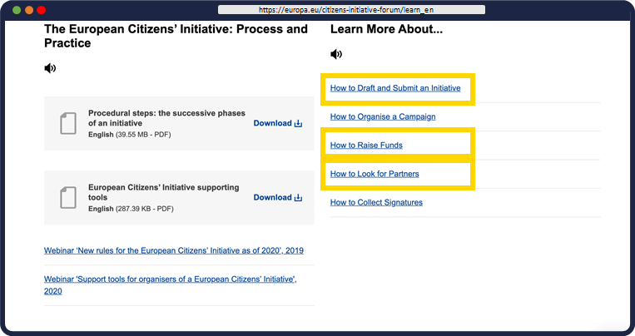
LEARN
Webinars
Guidance Notes
Success Stories
Testimonies

Slide 38
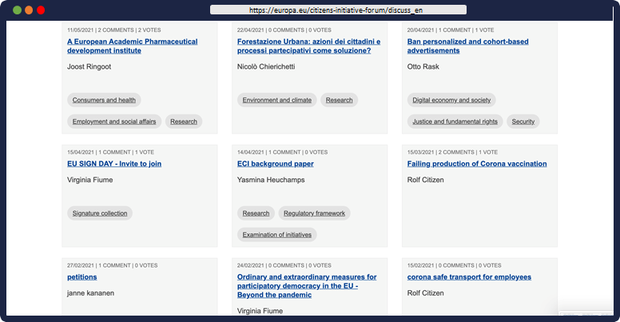
DISCUSS

Slide 39
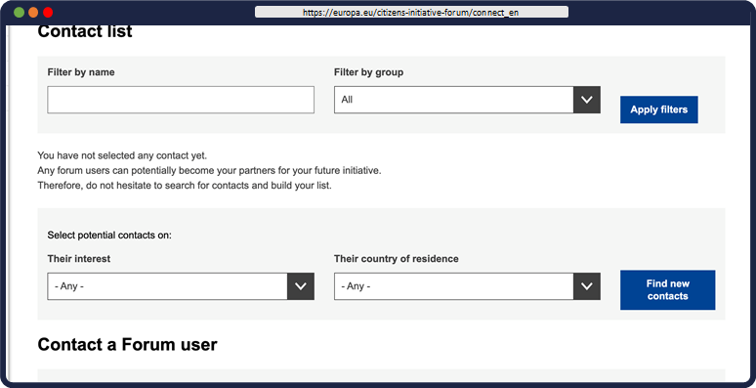
CONNECT

Slide 40
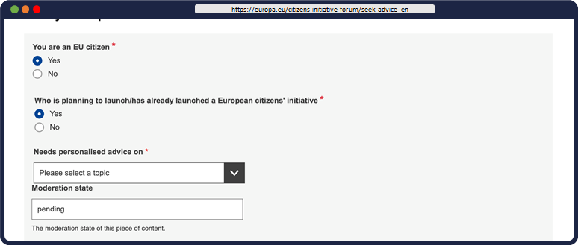
SEEK ADVICE
Legal
Campaigning
Fundraising
Other...

Slide 41
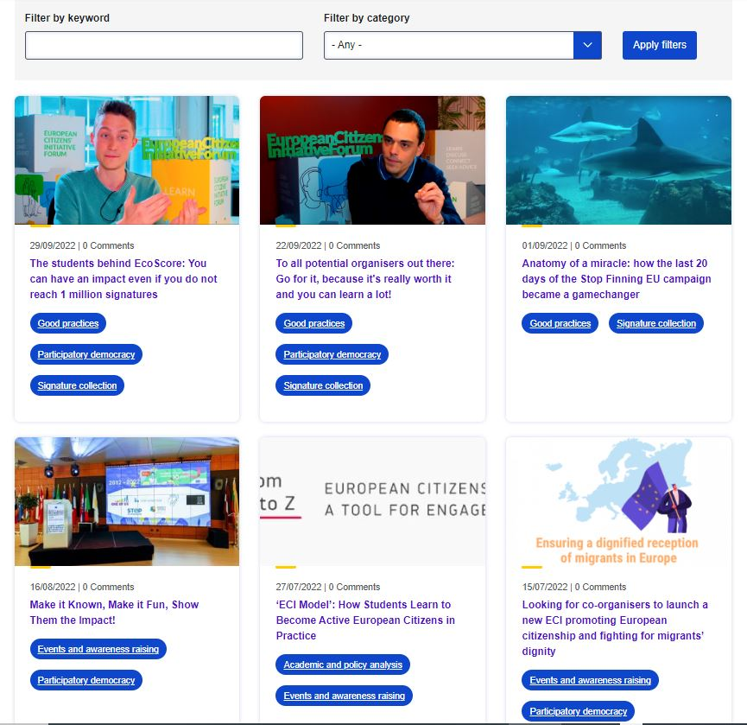
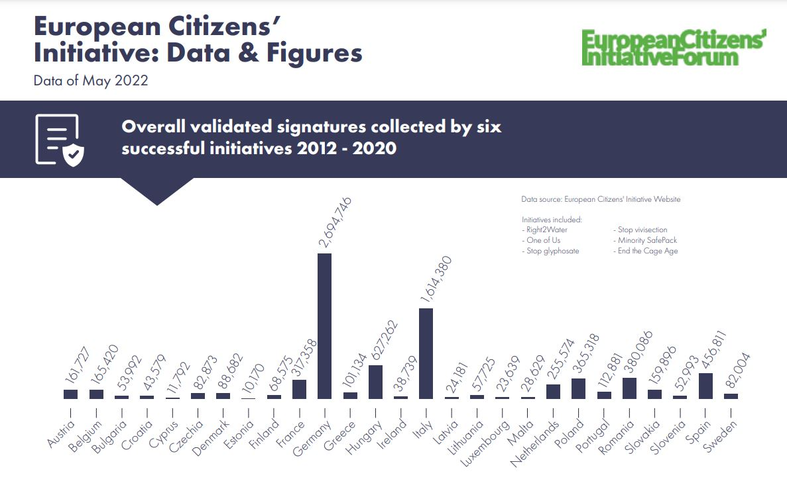
Other Resources on the Forum
ECI Infographic 2022
Blogs
Online course Citizens can learn more about the European Citizens' Initiative by joining our online course: Essential Skills for European Citizens' Initiative Organisers
Notes:
https://academy.europa.eu/courses/essential-skills-for-european-citizens-initiative-organisers

Slide 42
Are you ready to get involved? Looking forward to 2023-24 and the ECI Ambassador programme!

Slide 43
Communicating in 2023
Selecting 6 focus countries: Spain, Sweden, Italy + 3 others
Hook: EU Year of Skills
ECI Educational Module
‘Save Bees and Farmers’ initiative – many moments to communicate about
Other successful (and newly registered) initiatives to come

Slide 44
Invitation to join as ECI Ambassadors
Looking for new Ambassadors (especially in: AT, BE, DK, FI, DE, IT, LV, LT, MT, NL, RO, SE)
ECI Ambassadors benefit from:
Enhanced visibility (on our website, newsletter, events, press opportunities)
Receiving sample social media posts for (easy) distribution
Media training and invitation to events
Access to regular online meet-ups to engage with others and hearing news first
Country-specific information about ECI upon request
Our expectations:
Share information about the ECI within your network and via your regular activities
Minimum 6 actions per year - e.g. posting on social media, writing blog/newsletter articles, mention ECI in presentations, participating in national events, etc.
Provide insights into the national landscape of participatory democracy in your country

Slide 45
Q&A

Slide 46
Find out more & stay in touch
ECI website: https://europa.eu/citizens-initiative/
ECI Forum website: https://europa.eu/citizens-initiative-forum/
Subscribe to the monthly newsletter (EN+ 23 languages): https://europa.eu/citizens-initiative/newsletter/subscribe_en
Subscribe to CitizenCentral Podcast: https://europa.eu/citizens-initiative/citizencentral-podcast_en
Local contacts: ECI Ambassadors and National Contact Points
Notes:
https://europa.eu/citizens-initiative/_en
https://europa.eu/citizens-initiative-forum/_en
https://europa.eu/citizens-initiative/newsletter/subscribe_en
https://europa.eu/citizens-initiative/spread-word/eci-ambassadors_en
https://europa.eu/citizens-initiative/how-it-works/implementation-national-level/contact-points-national-level_en

Slide 47
Thank you!
Please feel free to be in touch
SG-ECI-COMMUNICATION@ec.europa.eu

