Slide 1
EU DEMOCRACY
IN ACTION
Have Your Say with the
European Citizens’
Initiative
Webinar – 11 May 2023

Slide 2
What is the European Citizens’ Initiative?
The European Citizens’ Initiative allows EU citizens to influence EU policies by putting on the European agenda the issues that matter most to them.
A citizens’ initiative brings together people from different EU countries to collect signatures and call on the European Commission to propose laws in areas where the Commission has powers to act.
It is a bottom-up way of starting a political debate and raising awareness of common causes which unite people across borders.
The tool was launched in 2012, and is now bearing fruit, with several initiatives leading to concrete legal proposals by the European Commission.

Slide 3
What is the European Citizens’ Initiative?
Key facts and figures:
Available to EU citizens since 2012
100 new ideas for ECIs registered
7 initiatives answered
8 initiatives currently collecting signatures (3 to start soon)
2 initiatives waiting for a response

Slide 4

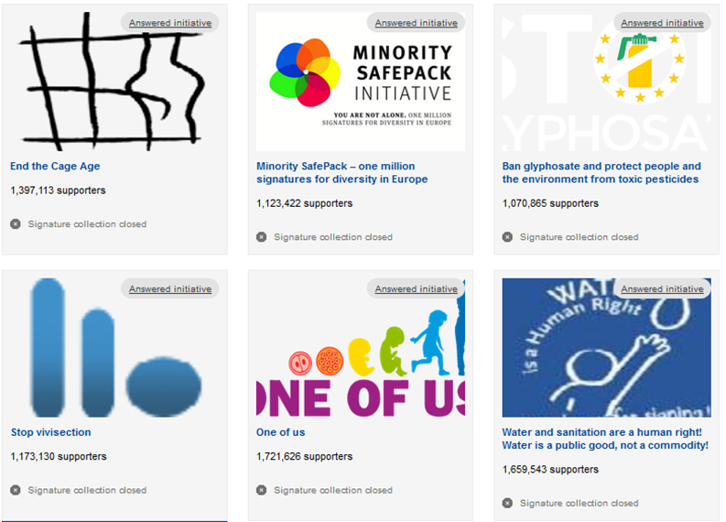


Successful Initiatives
Notes:
Save Bees and Farmers – submitted last week.

Slide 5
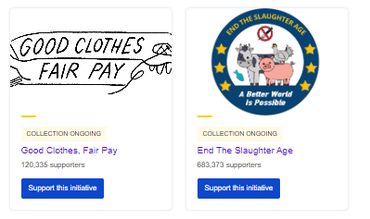
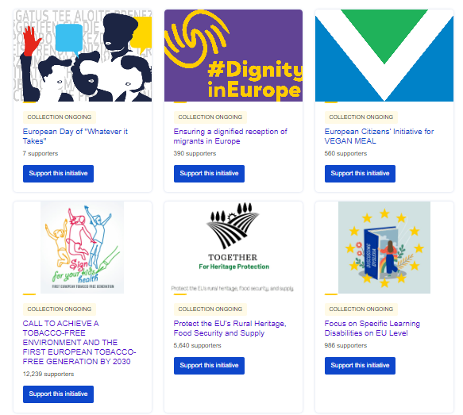
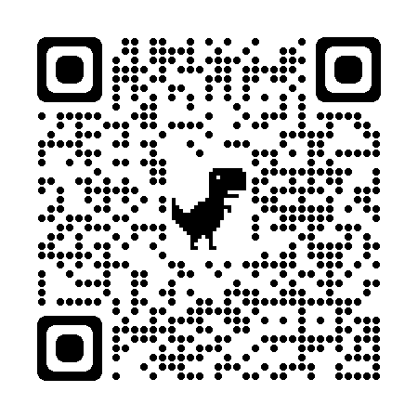
Ongoing Initiatives
Support an initiative

Slide 6
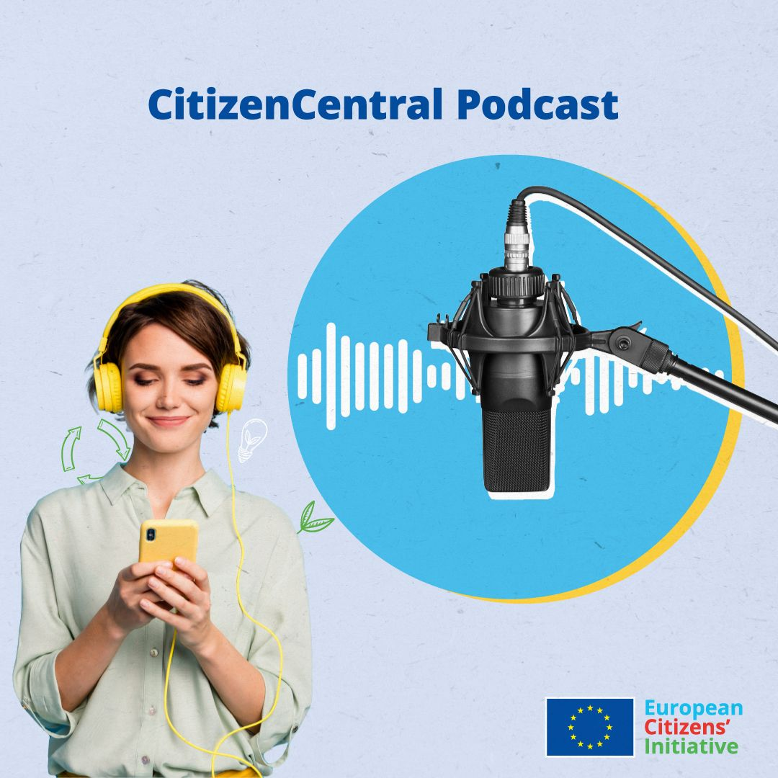

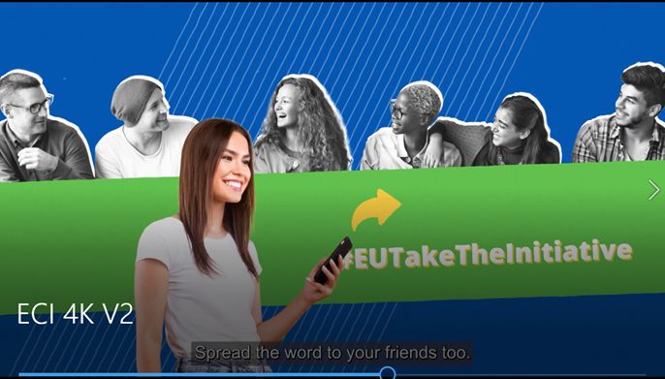
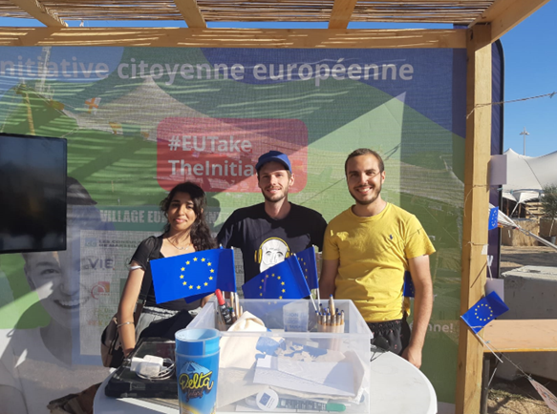
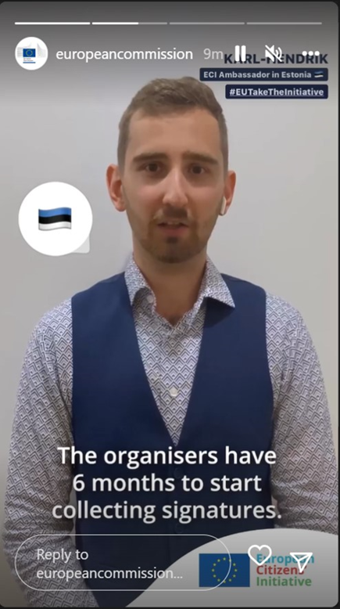
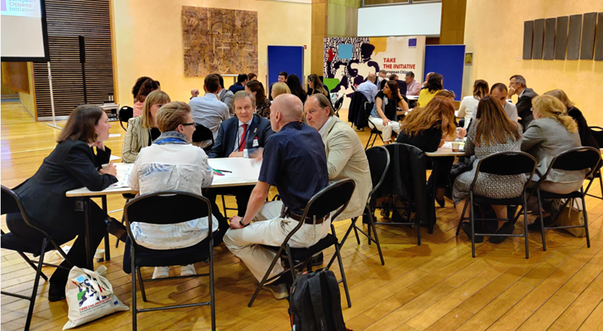
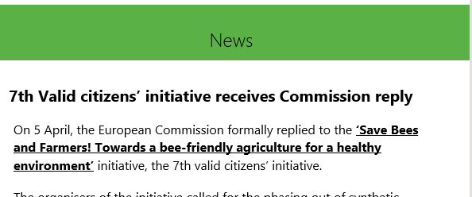
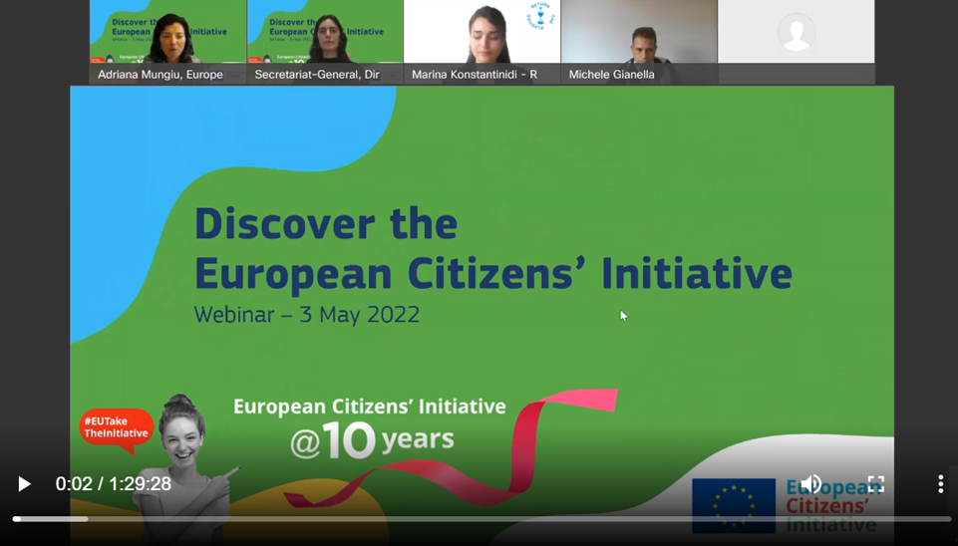
ECI communication activities

Slide 7
Why teach about the ECI and participatory democracy?
There are misconceptions about the EU.
Once they leave school, young people are less likely to come across information about how they can participate.
A basic knowledge of how the EU works is important for young people to become active citizens.
The ECI is a way for EU citizens to directly affect EU policy/law.
Young people have many concerns (e.g. environmental issues).

Slide 8
What will learners gain?
Confirmation that their voice can be heard.
Awareness that cooperation is an effective tool.
Basic knowledge of how the EU works.

Slide 9

What methods will be used?
Direct presentation
Group discussion
Group work
Individual study
Research work (for home or class)
Project work (including video filming)
Problem solving

Slide 10

Unit 1 - A Brief Introduction to the EU
Aims and objectives:
Identify the values of the EU
Introduce the Schengen Area
and the European single market
Identify EU areas of action

Slide 11
Example of class work

Slide 12
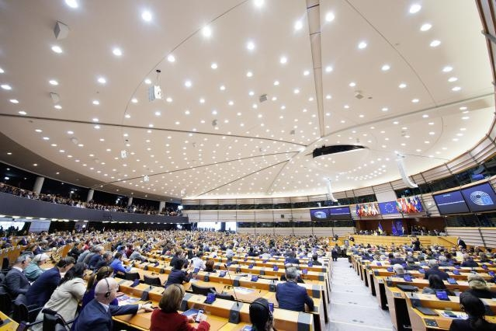
Unit 2 - Democracy in the EU
Aims and objectives:
Introduce the idea of participatory democracy
Introduce the main legislative bodies of the EU
Explain how EU laws are made
Introduce the idea of the European Citizens’ Initiative

Slide 13
Example of class work

Slide 14

Unit 3 - The European Citizens’ Initiative
Aims and objectives:
Introduce the European Citizens’ Initiative
Encourage students to think of issues that are important to them and that would be relevant at EU level

Slide 15
Example of class work

Slide 16
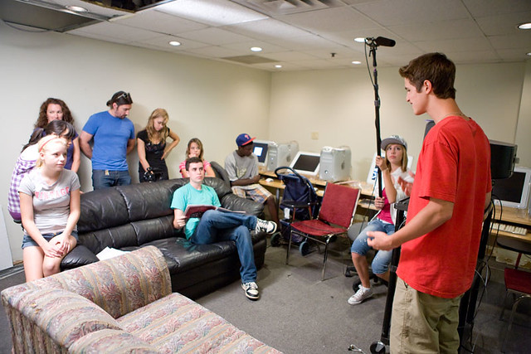
Unit 4 - Develop and Promote an ECI
Aims and objectives:
To have students create their own campaign
To explore communication skills

Slide 17

Example of class work
This Photo by Unknown Author is licensed under CC BY-SA-NC

Slide 18
QR Codes
Product Highlights
Icons
Fact sheets
4 optional activities

Slide 19
Materials included
(available in all EU official languages soon)
Teacher’s Pack
Lesson plans and answer key
Info boxes
Links for further research
History of the EU factsheet
Optional project work activities
Exit quiz
PowerPoints (including video)
Student’s Pack
Class work
Homework (revision and extension)
Links to related EU websites (QR codes)
Guide for making the video
Factsheets

Slide 20
A teacher’s experience –
Małgorzata Malczyk, teacher in Warsaw, Poland

Slide 21
Q&A Time

Slide 22
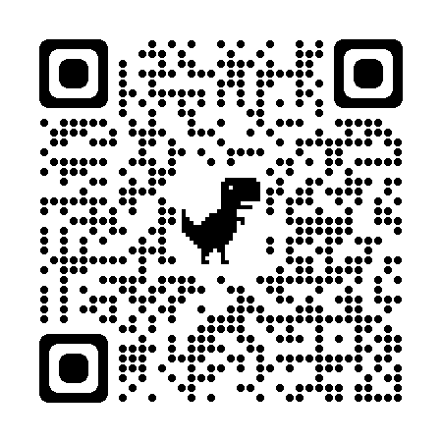
Thank You!
https://europa.eu/citizens-initiative/eci-school/eci-educational-toolkit_en

