Slide 1
ImagineEU competition Imagine the change you want to see in the European Union!

Slide 2
Contents
The concept
The toolkit
The prize
Step-by-step process
Conditions for entry
The benefits of the competition
Timeline

Slide 3

The concept
The ImagineEU competition asks teenagers to think of how the EU could become an even better place to live!
Inspired by the European Citizens’ Initiative (ECI), students are called on to learn more about how to be active citizens in the EU.
In groups, they think of a change they would like to see in the EU and make a short video explaining their idea.

Slide 4

The toolkit
Teachers can use the toolkit “EU Democracy in Action’- Have your say with the European Citizens’ Initiative” to introduce students to the topic of democratic participation in the EU.

Slide 5
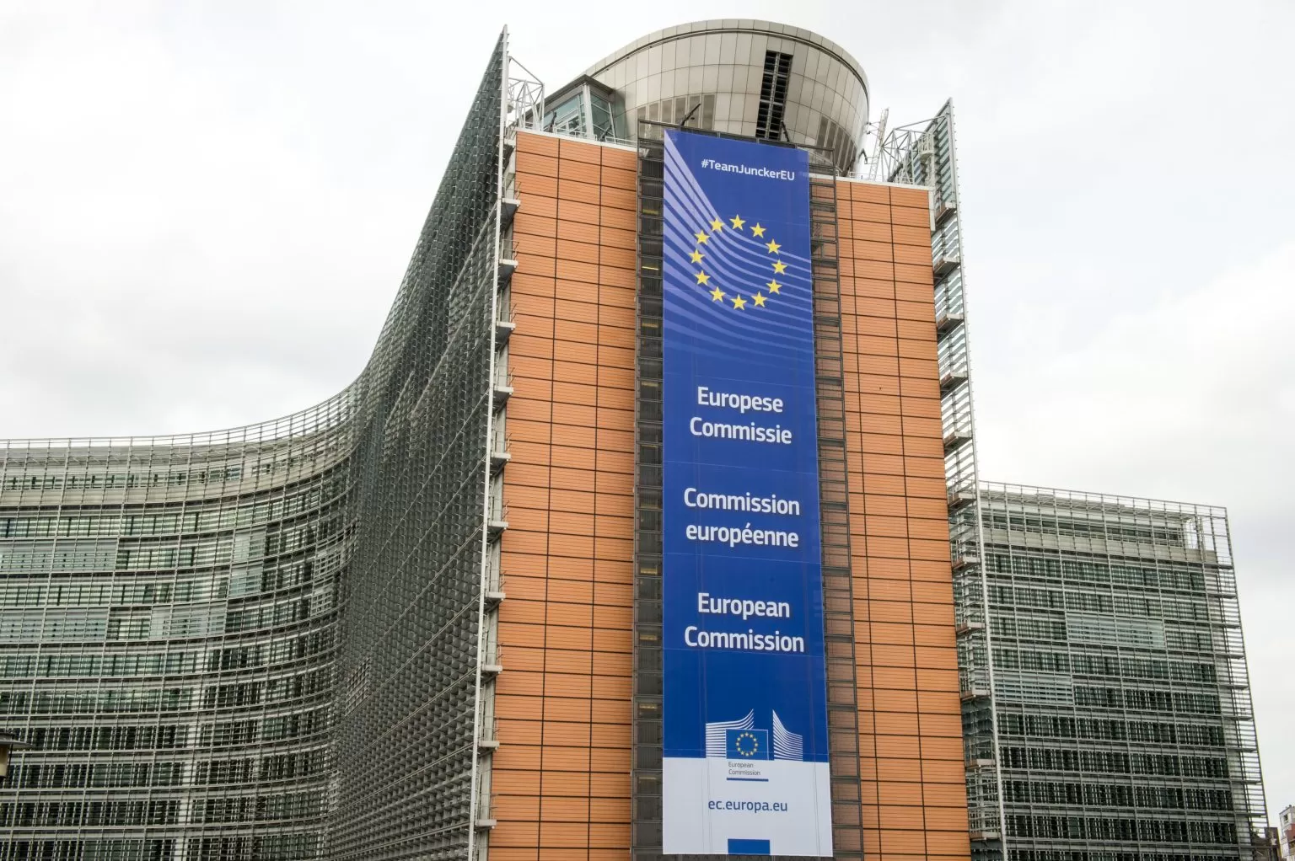
The prize
3 winning teams will win a study trip to Brussels ( 21 - 23 March 2024)
and learn more about how EU policies and laws are made and how EU citizens can get involved in the EU.

Slide 6
Step-by-step process
1. Creation of a team (up to 7 students)
1
Select a topic and produce a video
2
Evaluation of the eligibility of the video
4
Publication of the eligible videos
5
Public voting
6
Award
8
Jury evaluation
7
Submission of the application
3

Slide 7
Conditions for entry
Up to seven students from the same school, in their final two years of secondary education (from all EU countries).
The video should address a topic falling within at least one of the areas of competence of the European Commission – as is the case with European Citizens’ Initiative (see next slide).
Each video should be up to three minutes long; produced and submitted in any of the official EU languages, accompanied by a transcript in English.
The application should be made by a supervising teacher, who will also accompany the students to Brussels if they win.
The video should be uploaded to Vimeo or YouTube, and a link included in the application form.
Consent forms should be submitted for each student appearing in the video, duly completed and signed.

Slide 8











Competences of the EU
EMPLOYMENT &
SOCIAL AFFAIRS
NON-DISCRIMINATION
& CITIZENSHIP
EDUCATION, TRAINING,
YOUTH & SPORT
JUSTICE, FREEDOM & SECURITY
WHERE CAN CITIZENS
MAKE A DIFFERENCE
WITH THE EUROPEAN
CITIZENS' INITIATIVE?
HUMANITARIAN AID, DEVELOPMENT & COOPERATION
And many others…
ENVIRONMENT & CLIMATE ACTION
CONSUMER
PROTECTION
PUBLIC
HEALTH
ENERGY
ARGICULTURE &
FISHERIES

Slide 9

Students will…
Practice working in teams
Learn more about EU values, competences and fundamental rights
Understand more about how the EU and European legislation work
Learn how to express their concerns and promote their ideas
Become active participants rather than passive spectators

Slide 10
Timeline
Submission
of applications
Announcement
of the winners
16 October 2023 - 13 December 2023
by 20 February 2024
Public voting
period
Award (study
trip to Brussels)
20 December 2023 - 28 January 2024
21 - 23 March 2024

Slide 11
Find out more & stay in touch
ECI website https://europa.eu/citizens-initiative/
ECI Forum websitE https://europa.eu/citizens-initiative-forum/
monthly newsletter (EN+ 23 EU languages) https://europa.eu/citizens-initiative/newsletter/
ECI EDUCATIONAL TOOLKIT https://citizens-initiative.europa.eu/schools/eci-educational-toolkit
FB grouP https://www.facebook.com/groups/eciofficialgroup
Local contacts
ECI Ambassadors & National Contact Points
CitizenCentral Podcast https://europa.eu/citizens-initiative/citizencentral-podcast_en

Slide 12
Thank you!

