Slide 1
Discover the European Citizens’ Initiative

Slide 2
Participatory democracy: options at EU level
Vote or run as a candidate in European elections
Public consultations /EU Have Your Say Portal
European Citizens’ Panels
Petitions to the European Parliament
European Citizens’ Initiative
Notes:
Save Bees and Farmers – submitted last week.

Slide 3
“What is the ECI?”
The European Citizens’ Initiative is a participatory democracy tool that gives EU citizens the right to have a say in EU policies that affect them, by calling on the European Commission to propose new laws. Once an initiative has reached 1 million signatures, the Commission will decide on what action to take.
To launch an initiative, it takes 7 EU citizens, living in at least 7 different Member States who are old enough to vote. If 1 million valid signatures are reached within 1 year – they meet with lawmakers and get an official response from the European Commission
Citizens’ initiatives must meet certain criteria
Notes:
Save Bees and Farmers – submitted last week.

Slide 4
“Why should I care about the ECI?”
The ECI brings new ideas that haven't been considered yet on the radar of EU and other policymakers
The ECI gives you and other EU citizens the right to take action on issues you care about – and you can help organisers by supporting their ideas
Notes:
Save Bees and Farmers – submitted last week.

Slide 5
Competences of the EU
EMPLOYMENT &
SOCIAL AFFAIRS
NON-DISCRIMINATION
& CITIZENSHIP
EDUCATION, TRAINING,
YOUTH & SPORT
JUSTICE, FREEDOM & SECURITY
WHERE CAN CITIZENS
MAKE A DIFFERENCE
WITH THE EUROPEAN
CITIZENS' INITIATIVE?
HUMANITARIAN AID, DEVELOPMENT & COOPERATION
And many others…
ENVIRONMENT & CLIMATE ACTION
CONSUMER
PROTECTION
PUBLIC
HEALTH
ENERGY
ARGICULTURE &
FISHERIES

Slide 6
Initiatives currently collecting support List Registered Initiatives - starting soon List

Slide 7
The ECI in action – 6 Steps to turn an idea into a citizens’ initiative

Slide 8
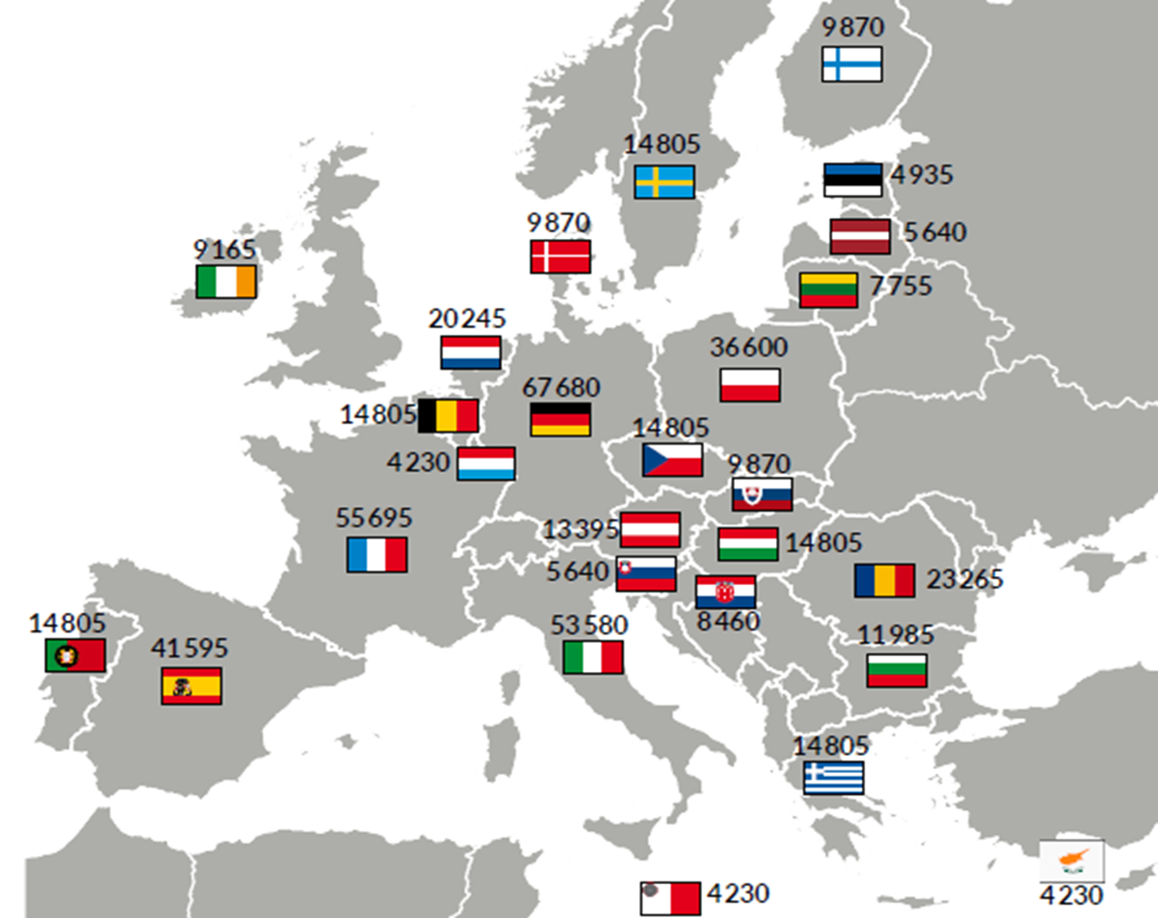
1 milion signatures in at least 7 EU countries
Notes:
Save Bees and Farmers – submitted last week.

Slide 9
“How can I get involved with the ECI?”
As an EU citizen, you can:
Sign an ongoing initiative
Support an initiative (volunteer time, promotion, etc.)
Start a new initiative
Notes:
Save Bees and Farmers – submitted last week.

Slide 10
Facts & Figures – overview since 2012 status: April 2024
111 initiatives
registered
9 initiatives
collecting signatures
10 initiatives replied by the EC
18 million+
signatures
collected
Notes:
Video: https://audiovisual.ec.europa.eu/en/video/I-214692?&lg=INT

Slide 11
What impact has the ECI made 12 years on? Key results, facts & figures

Slide 12
10 successful initiatives replied
Right2Water
One of us
Stop Vivisection
Ban Glyphosate & limit pesticides
Minority Safepack
End the Cage Age
Save Bees and Farmers
Stop Finning - Stop the Trade
Save Cruelty-Free Cosmetics
Fur Free Europe

Slide 13
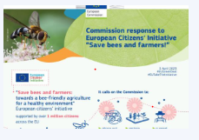
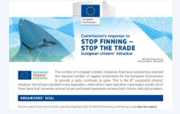
Initiatives answered in 2023
Notes:
Save Bees and Farmers – submitted last week.

Slide 14
What impact of the ECIs?
Access to clean drinking water is protected in the EU (Right2Water)
Authorisation processes of food-related products such as pesticides, additives or packaging materials are transparent; no more secret industry studies. (Ban glyphosate (..))
Work started on a roadmap to phase out animal testing for chemical safety assessments and on reducing animal testing in research (Cruelty-free cosmetics..)

Slide 15
What impact of the ECIs?
Work started towards better protection of sharks (Stop Finning) and farmed fur animals (Fur Free Europe)
Sparking policy debate (ban biometric surveillance, healthy soils, good clothes fair pay, tax the rich...)
Organising an ECI helps you increase visibility of your cause and expands your network

Slide 16
How to make the ECI better known to young people?

Slide 17
The toolkit
Teachers can use the Educational toolkit “EU Democracy in Action’- Have your say with the European Citizens’ Initiative” to introduce secondary school students to the topic of democratic participation in the EU.
The toolkit includes:
Manuals for teachers and students, including videos and interactive exercises
4 units in all languages

Slide 18
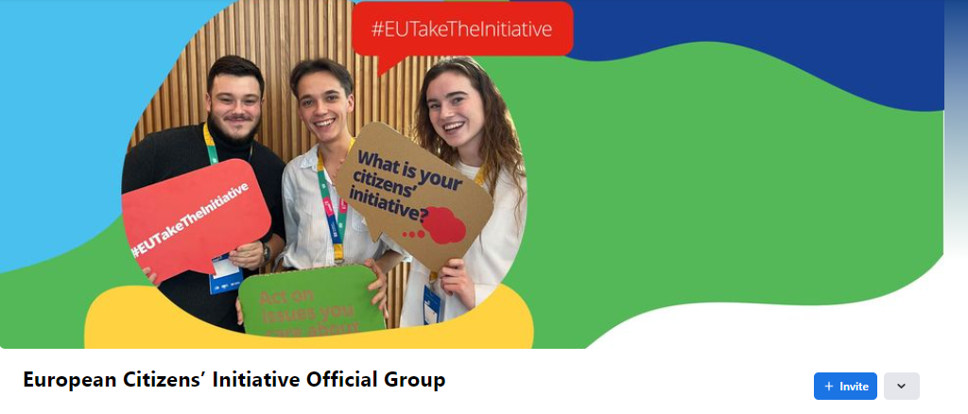
ECI Facebook group, #EuTakeTheInitiative

Slide 19
The European Citizens’ Initiative Forum
The Forum supports organisers in the preparatory phase and during the collection of signatures of their initiative!
LEARN
DISCUSS
CONNECT
SEEK ADVICE

Slide 20
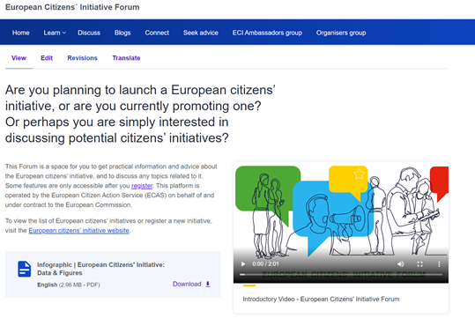
A great tool for organising an initiative!
Learn Section: Webinars, Guidance Notes, Learning Material, Testimonials
Blogs
Discussion forum
Seek Advice: for organisers who need legal, campaigning or fundraising advice before or during their campaign

Slide 21
Find out more & stay in touch
ECI website https://citizens-initiative.europa.eu
ECI Forum websitE https://citizens-initiative-forum.europa.eu
monthly newsletter (EN+ 23 EU languages) https://ec.europa.eu/newsroom/ecif/newsletter-archives/view/service/1501
ECI EDUCATIONAL TOOLKIT https://citizens-initiative.europa.eu/eci-school_en
FB grouP https://www.facebook.com/groups/eciofficialgroup
Local contacts
ECI Ambassadors & National Contact Points
CitizenCentral Podcast https://citizens-initiative.europa.eu/news/citizencentral-podcast_en

